Slide 1

Notes:
1.0 title · click 1 of 1
Title. Introduce the group and the topic in one sentence.

Slide 2
Notes:
1.0s section · click 1 of 1
Section 1: the problem.

Slide 3
Notes:
1.1 hook · click 1 of 5
Point: a route can look efficient and still fail customers.
This click: Road, restaurant, five customers.

Slide 4
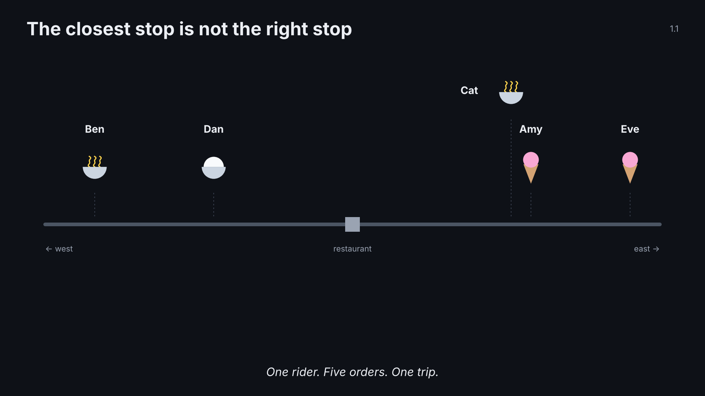
Notes:
1.1 hook · click 2 of 5
Point: a route can look efficient and still fail customers.
This click: Countdown rings: ice cream 30, noodles 60, rice 90.

Slide 5
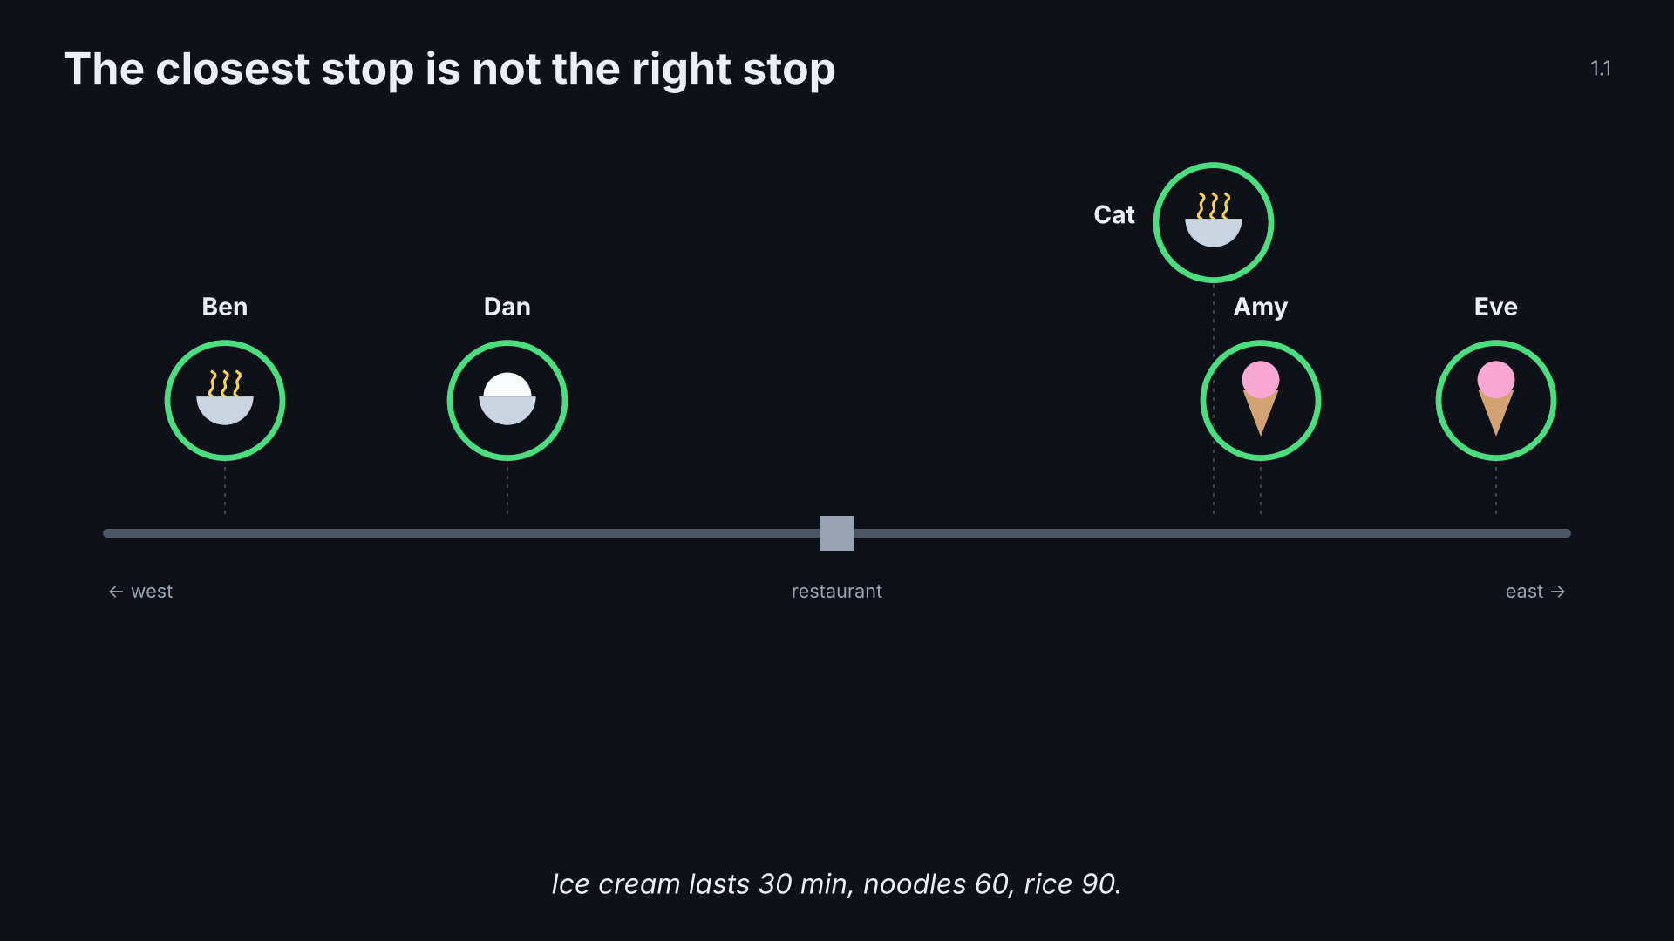
Notes:
1.1 hook · click 3 of 5
Point: a route can look efficient and still fail customers.
This click: Nearest neighbour drives: both ice creams melt.

Slide 6
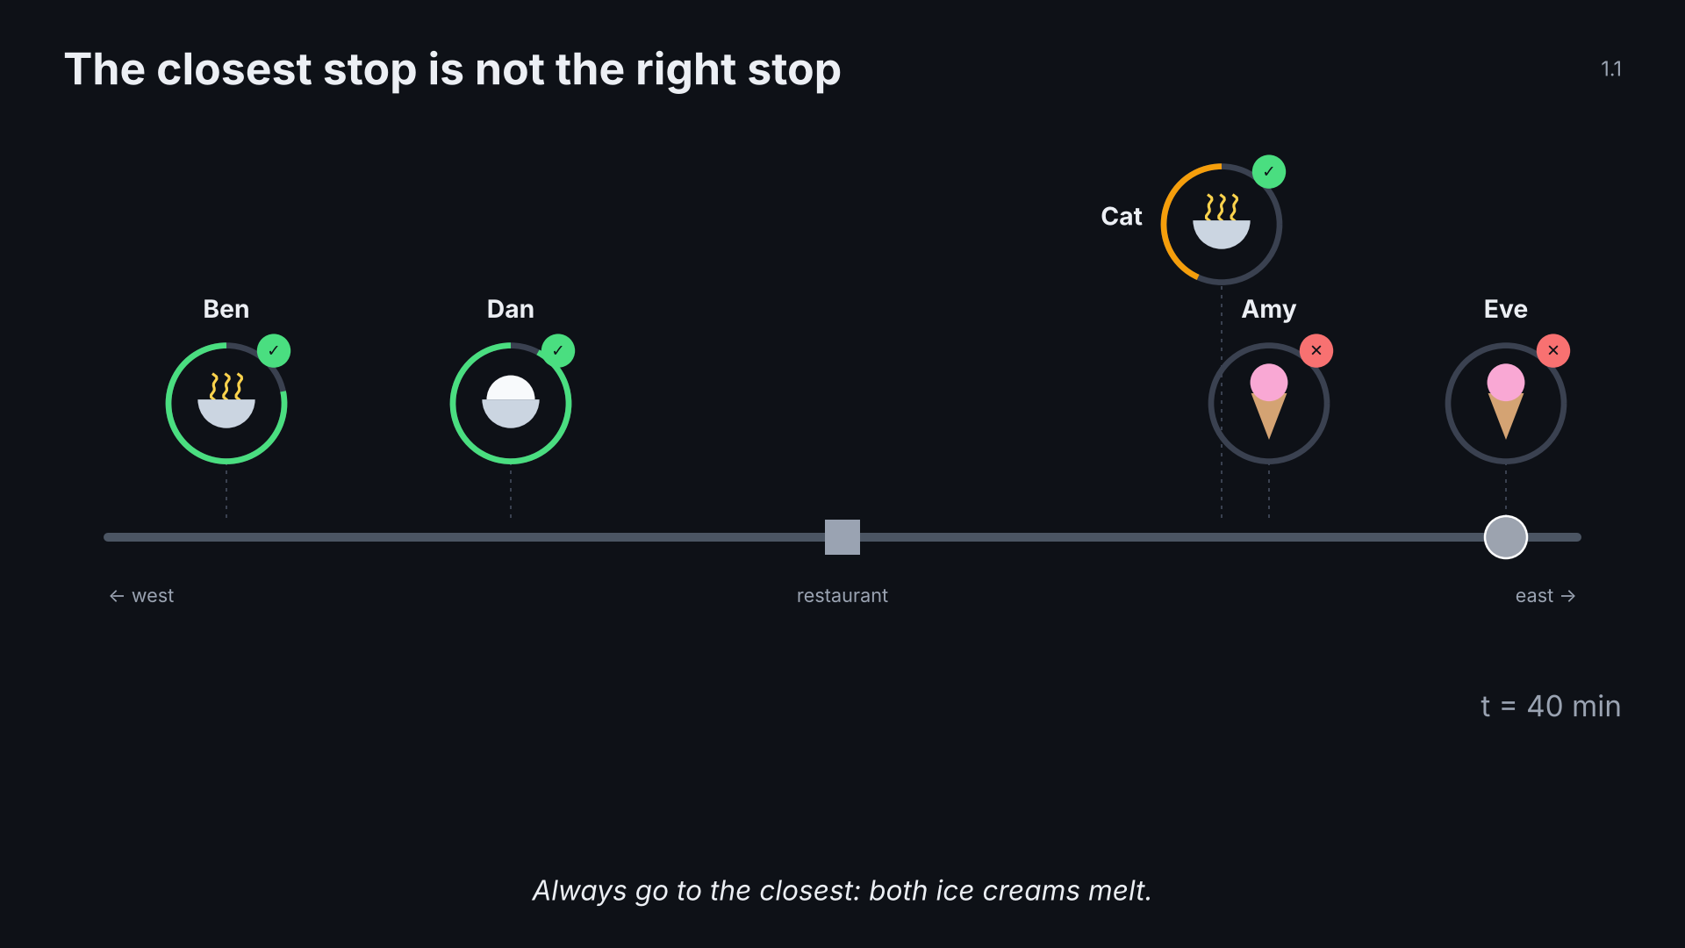
Notes:
1.1 hook · click 4 of 5
Point: a route can look efficient and still fail customers.
This click: Scoreboard: 3 of 5, 18.0 min.

Slide 7
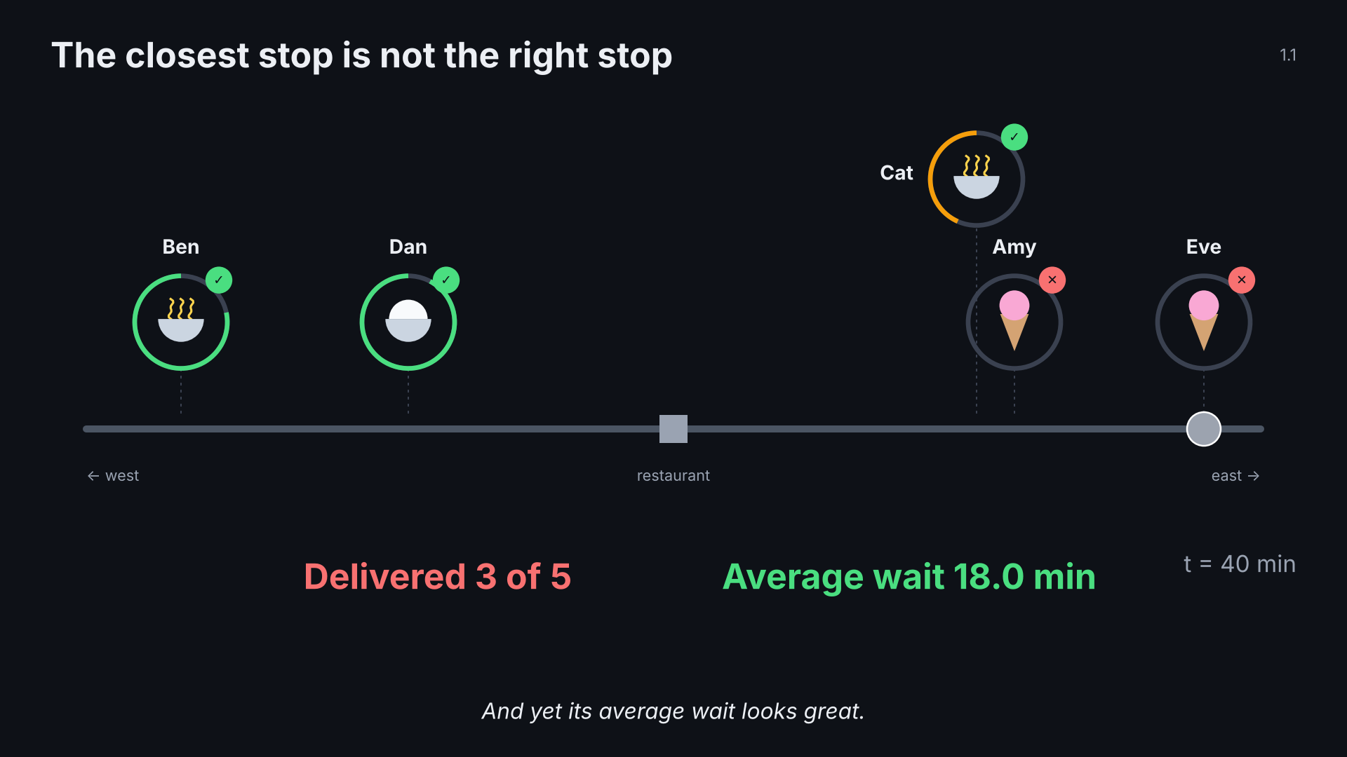
Notes:
1.1 hook · click 5 of 5
Point: a route can look efficient and still fail customers.
This click: Question: what does better even mean?

Slide 8
Notes:
1.2 classic TSP · click 1 of 7
Point: five classic assumptions break; one change per click.

Slide 9
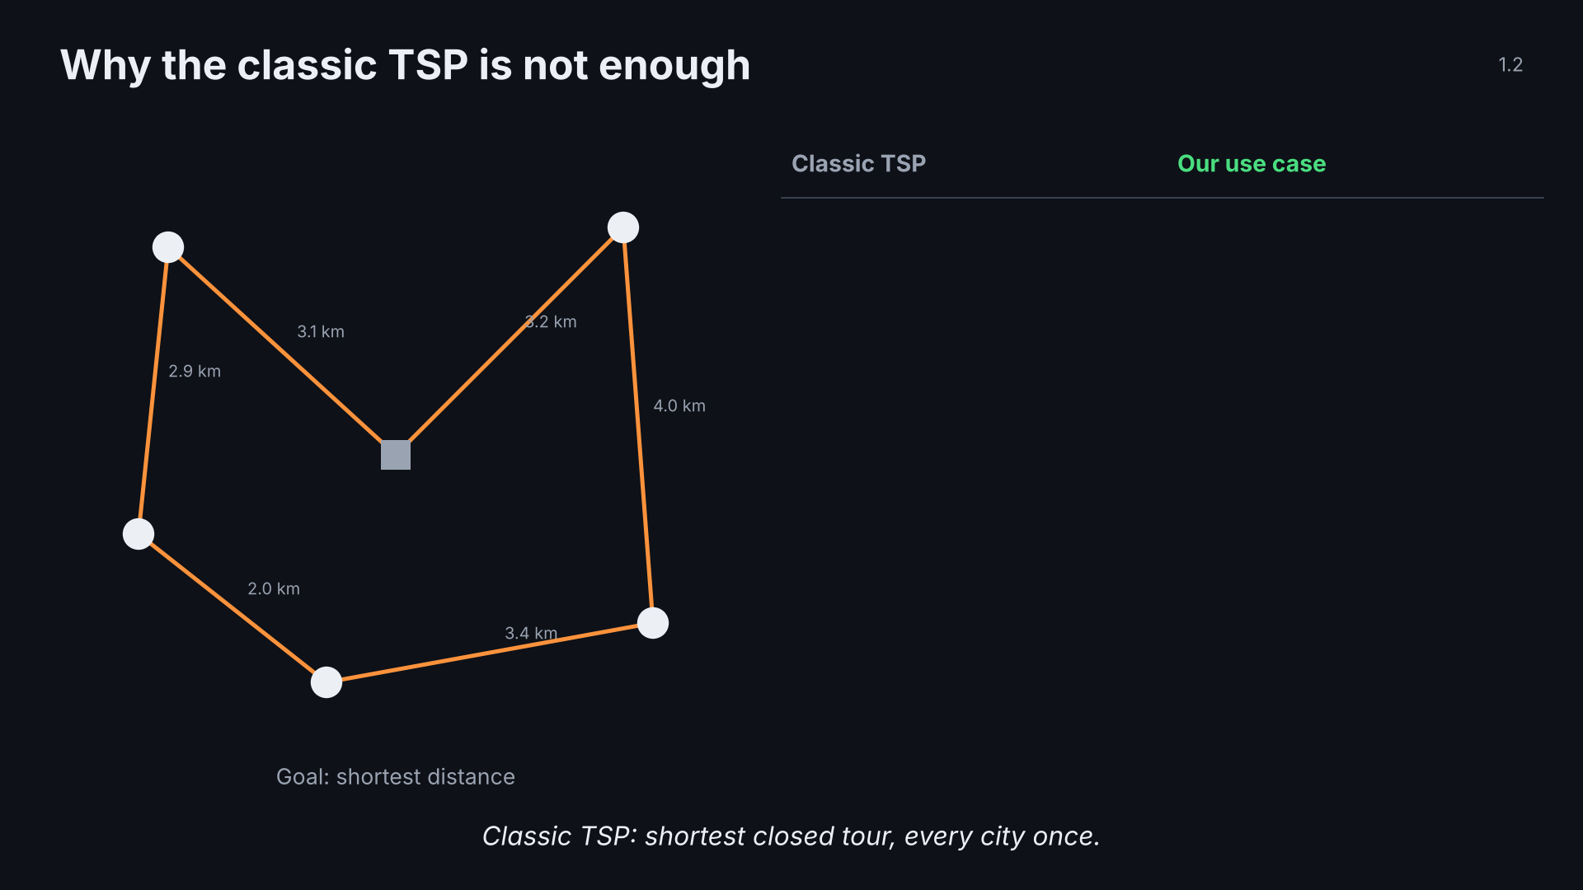
Notes:
1.2 classic TSP · click 2 of 7
Point: five classic assumptions break; one change per click.

Slide 10
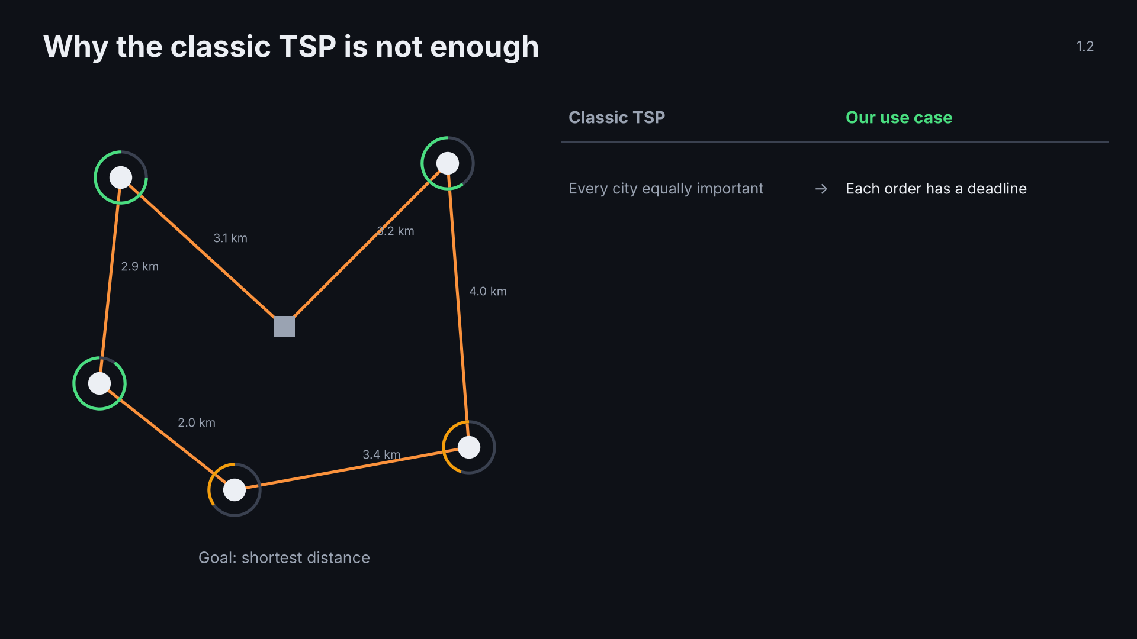
Notes:
1.2 classic TSP · click 3 of 7
Point: five classic assumptions break; one change per click.

Slide 11
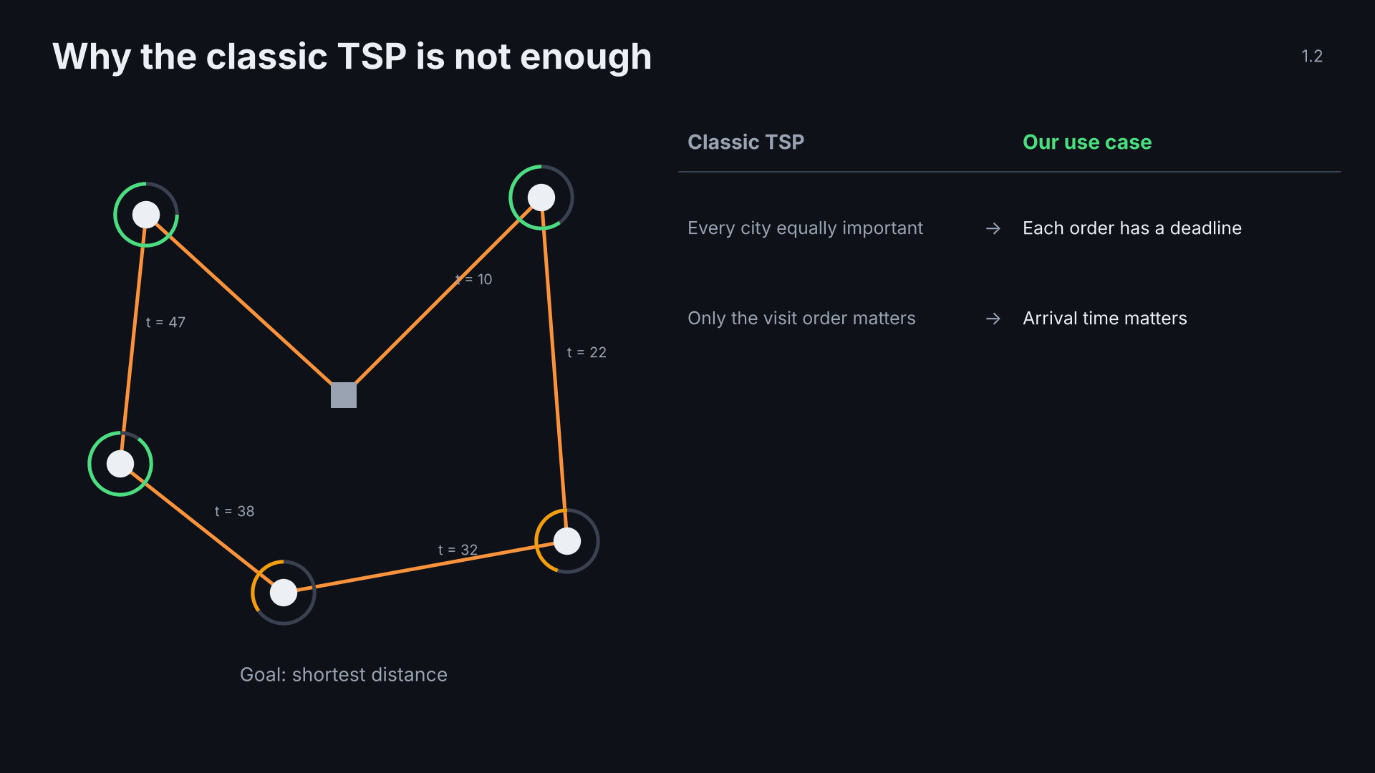
Notes:
1.2 classic TSP · click 4 of 7
Point: five classic assumptions break; one change per click.

Slide 12
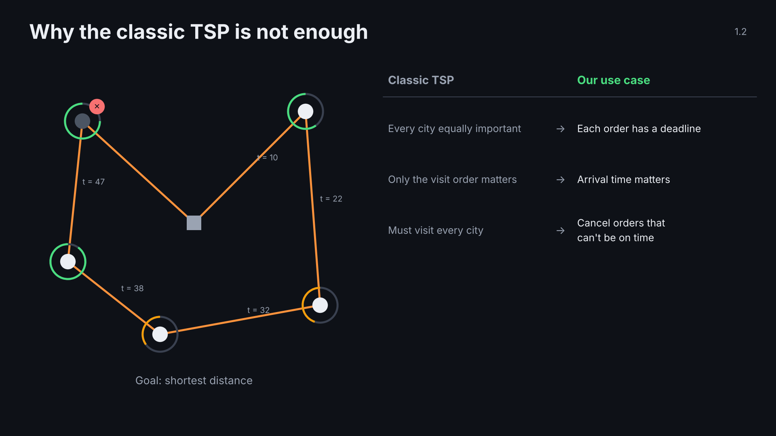
Notes:
1.2 classic TSP · click 5 of 7
Point: five classic assumptions break; one change per click.

Slide 13
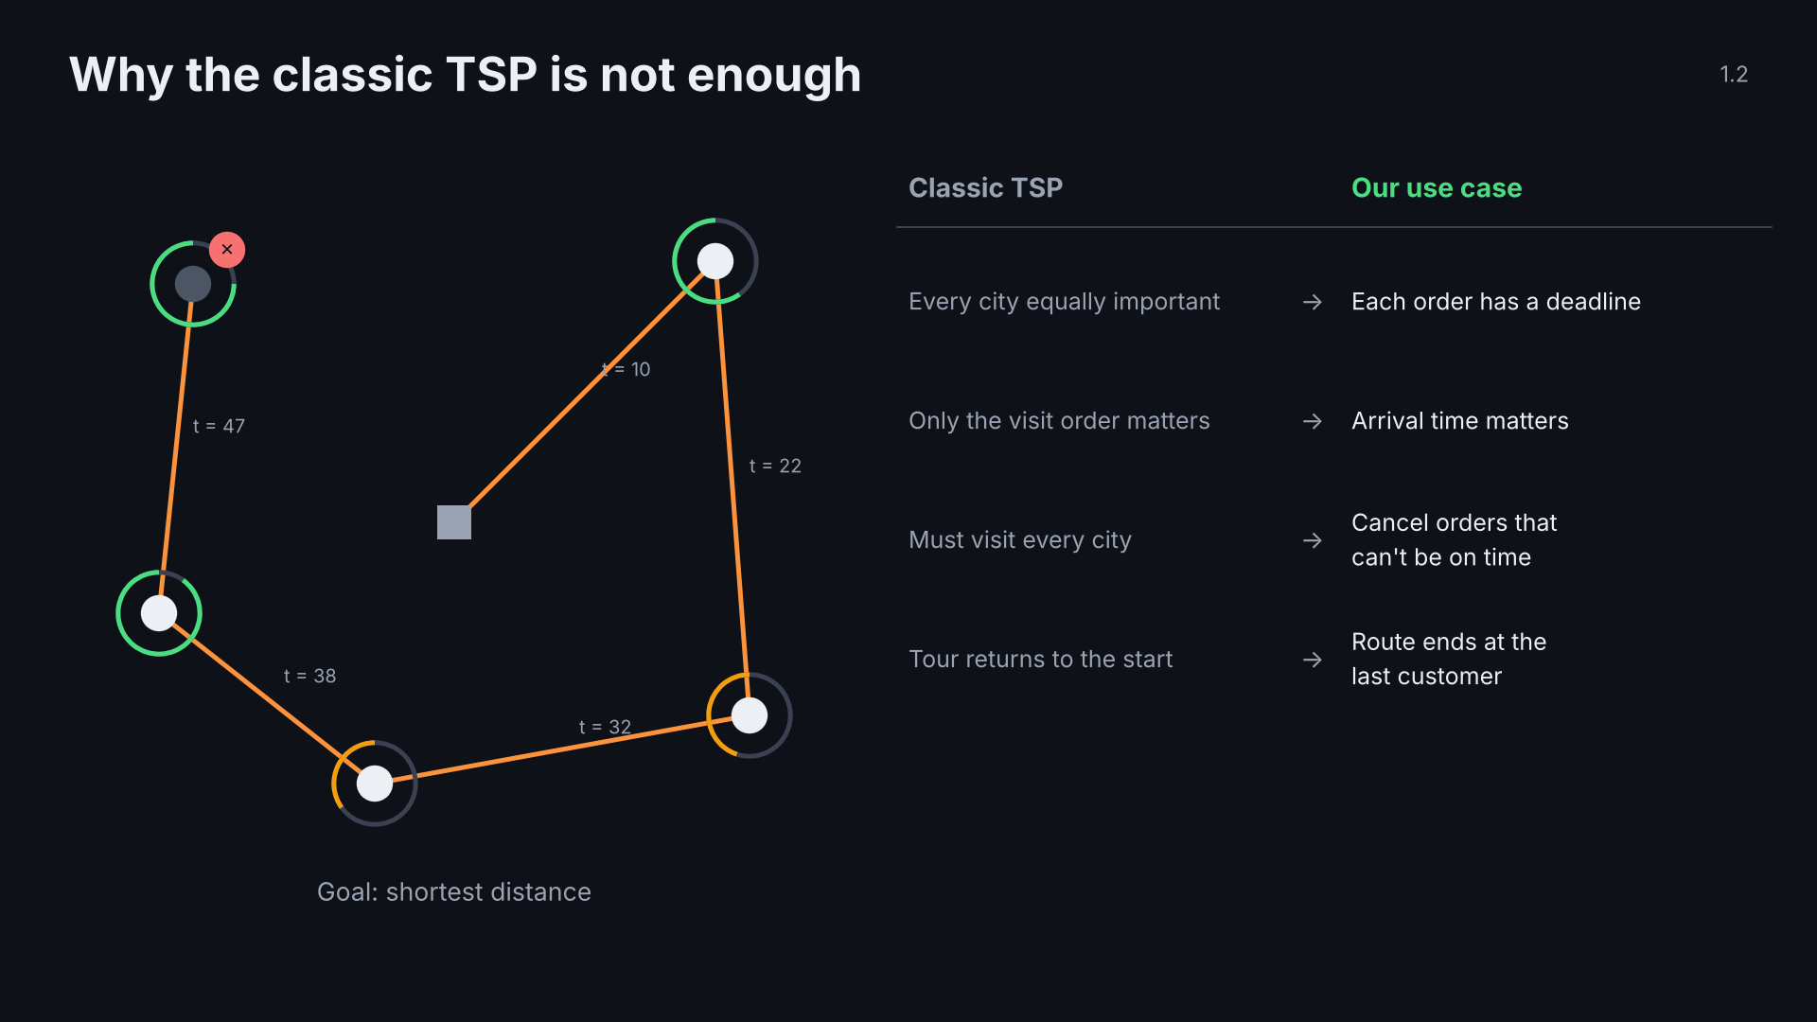
Notes:
1.2 classic TSP · click 6 of 7
Point: five classic assumptions break; one change per click.

Slide 14
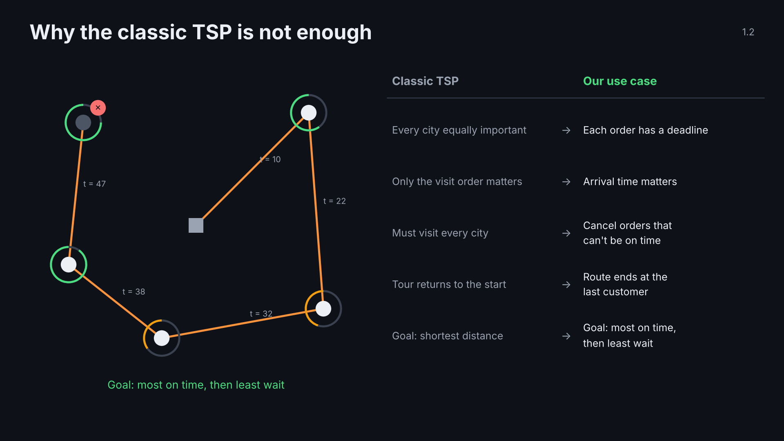
Notes:
1.2 classic TSP · click 7 of 7
Point: five classic assumptions break; one change per click.

Slide 15
Notes:
1.3 variant · click 1 of 6
Point: input, output, rules; goals compared in order.

Slide 16
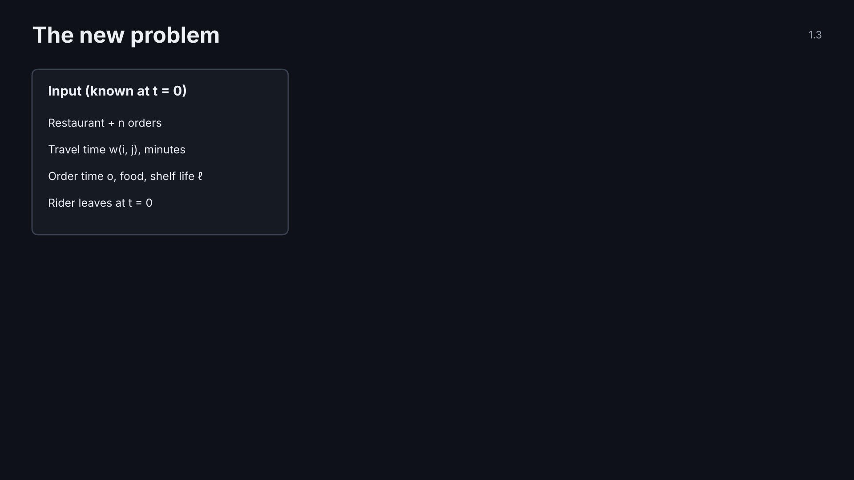
Notes:
1.3 variant · click 2 of 6
Point: input, output, rules; goals compared in order.

Slide 17
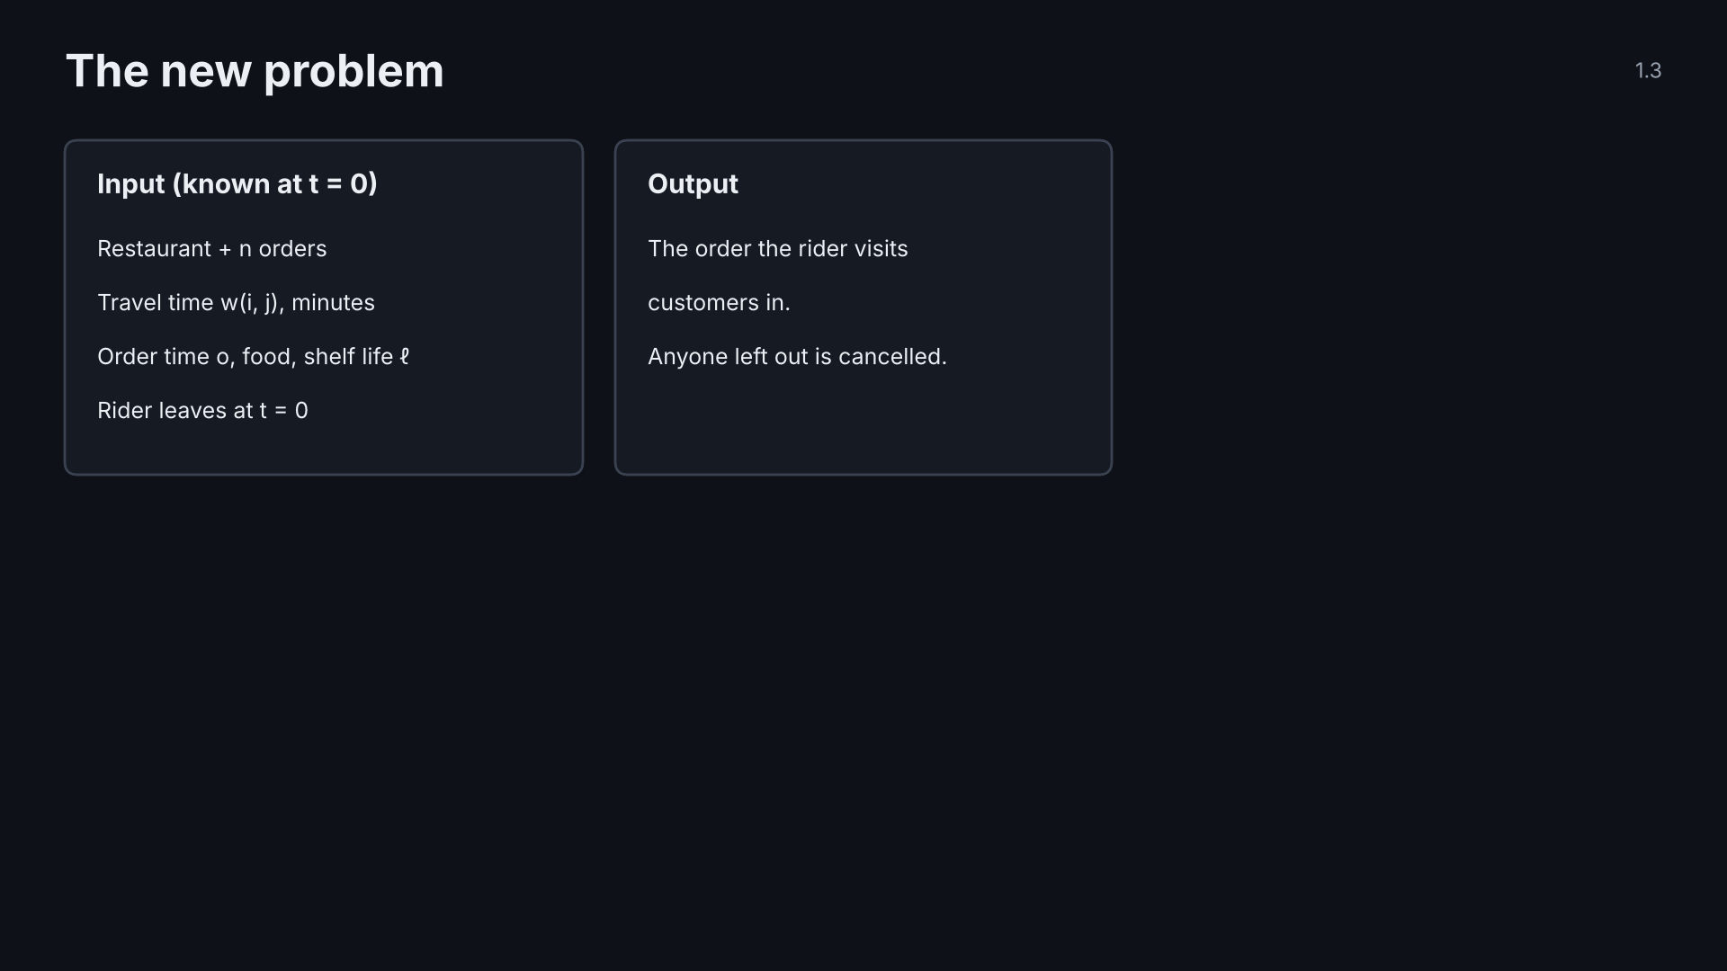
Notes:
1.3 variant · click 3 of 6
Point: input, output, rules; goals compared in order.

Slide 18
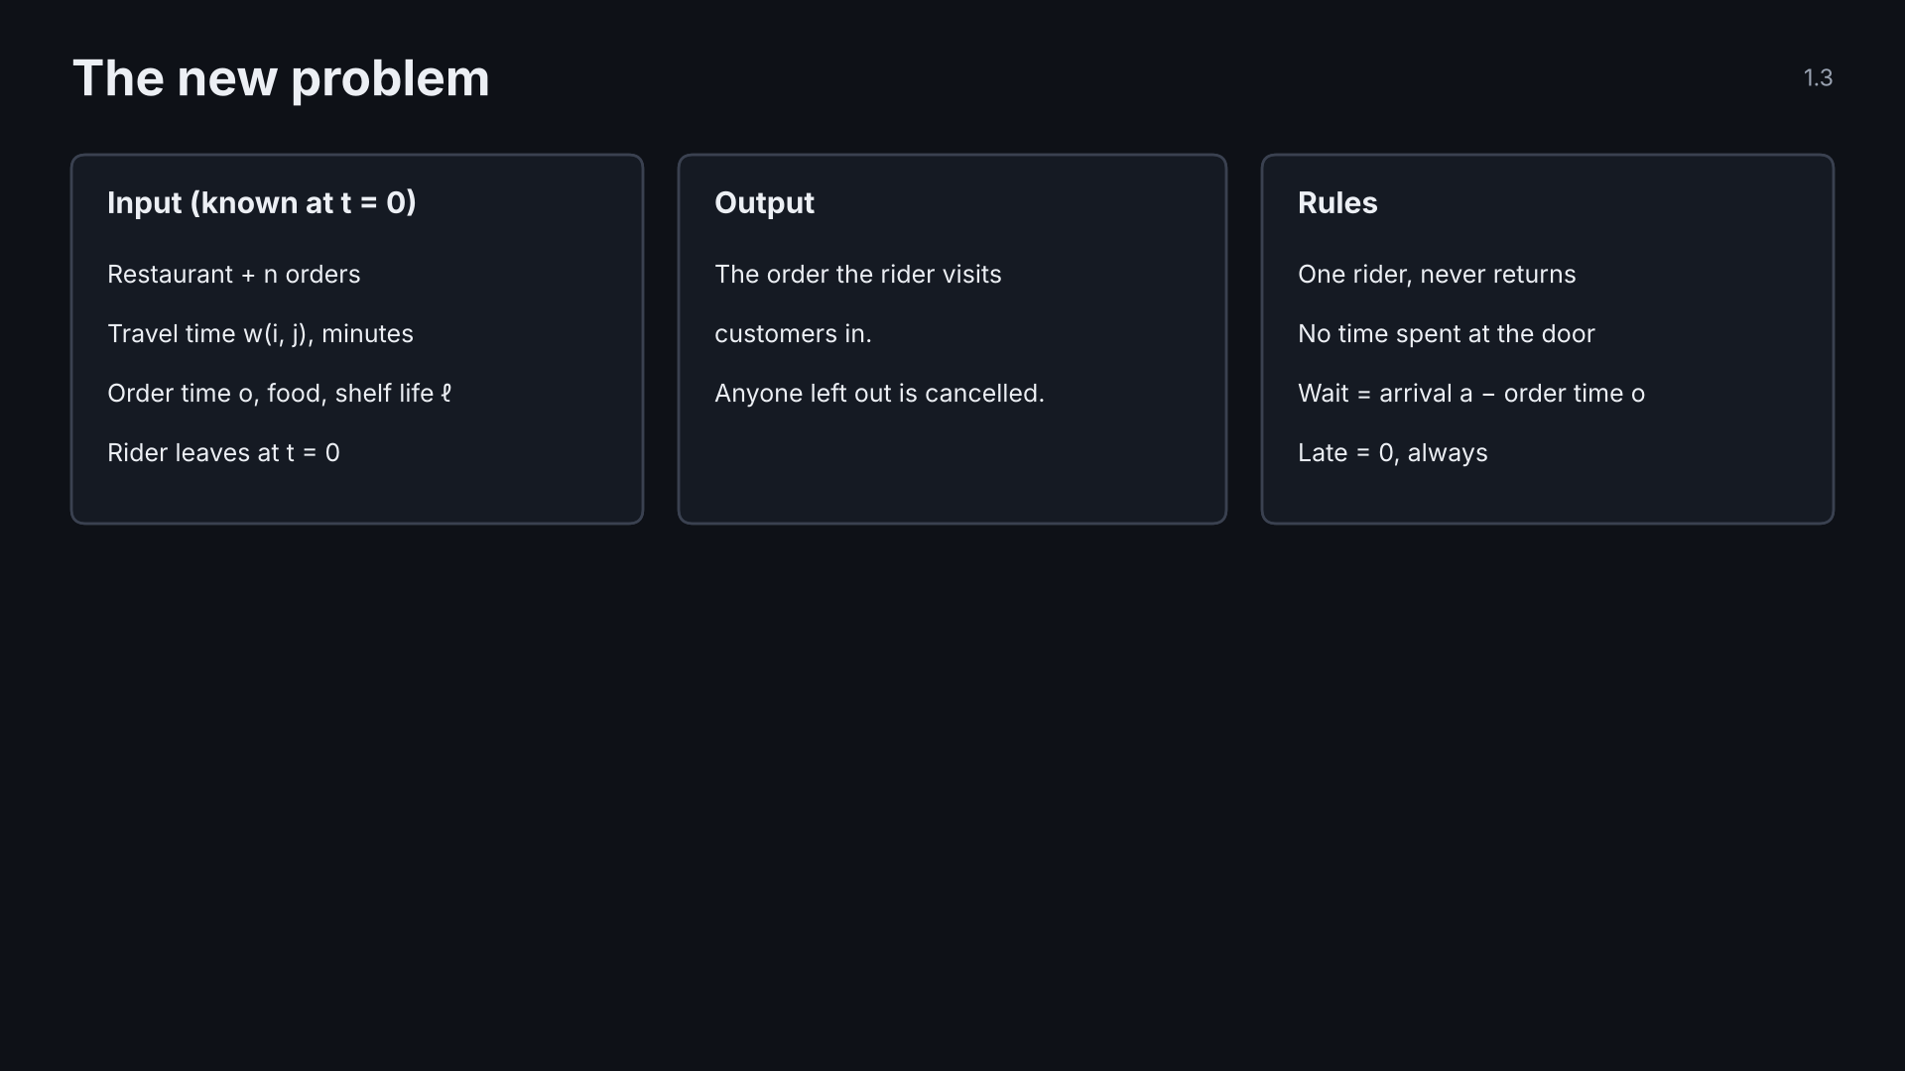
Notes:
1.3 variant · click 4 of 6
Point: input, output, rules; goals compared in order.

Slide 19
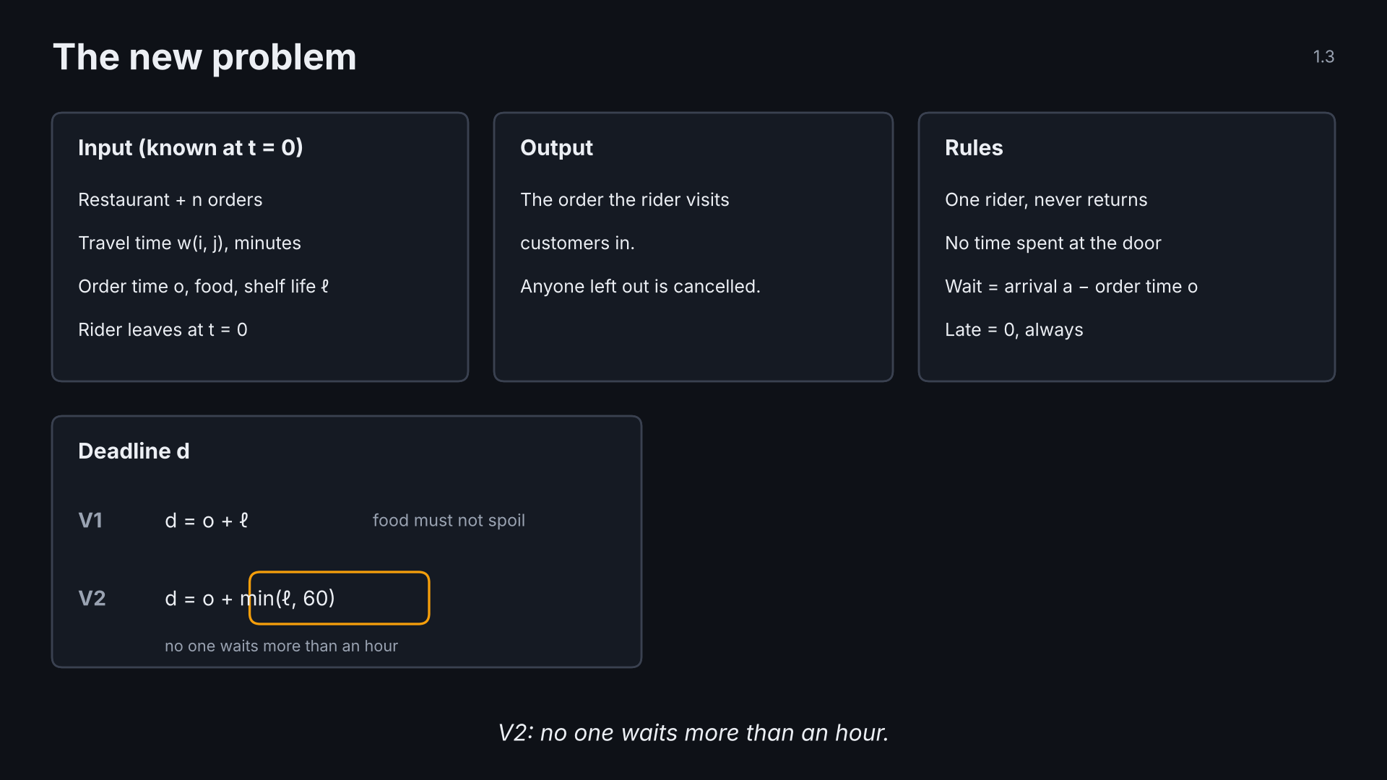
Notes:
1.3 variant · click 5 of 6
Point: input, output, rules; goals compared in order.

Slide 20
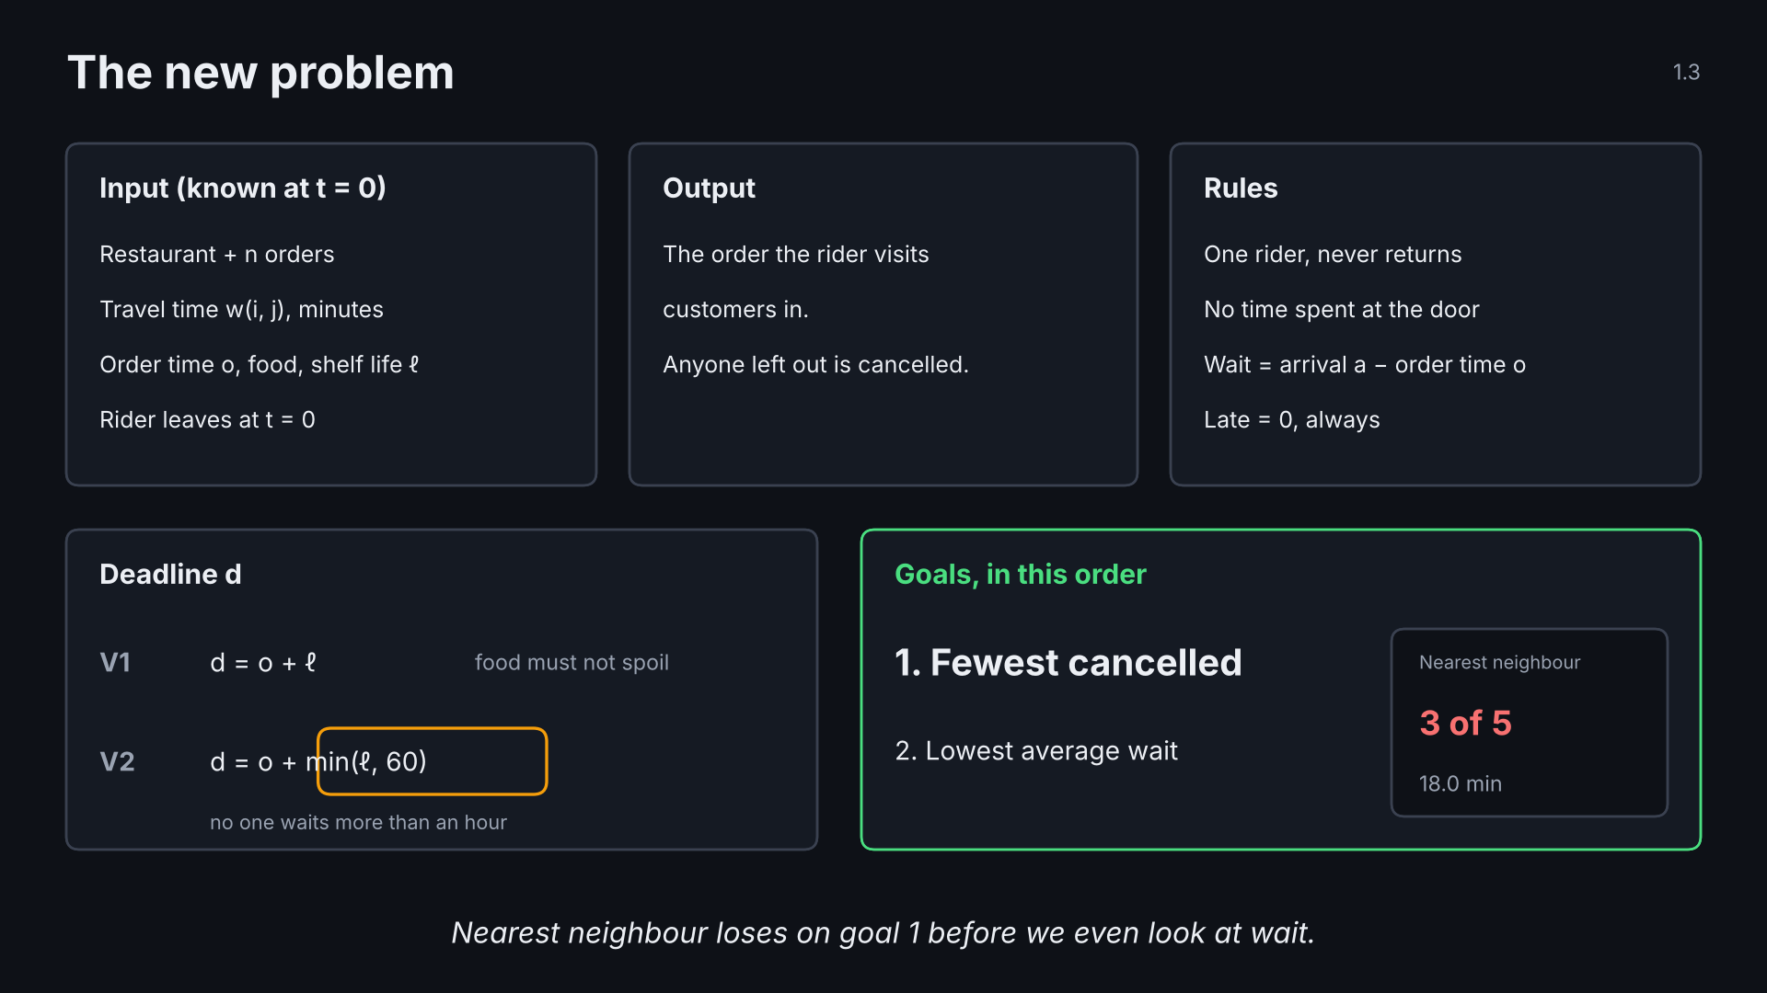
Notes:
1.3 variant · click 6 of 6
Point: input, output, rules; goals compared in order.

Slide 21
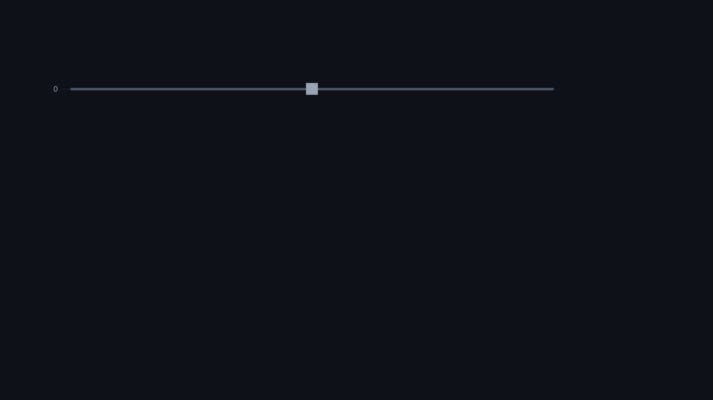
Notes:
1.4 time chart · click 1 of 5
Point: one chart shows where and when; reused for the rest of the talk.

Slide 22
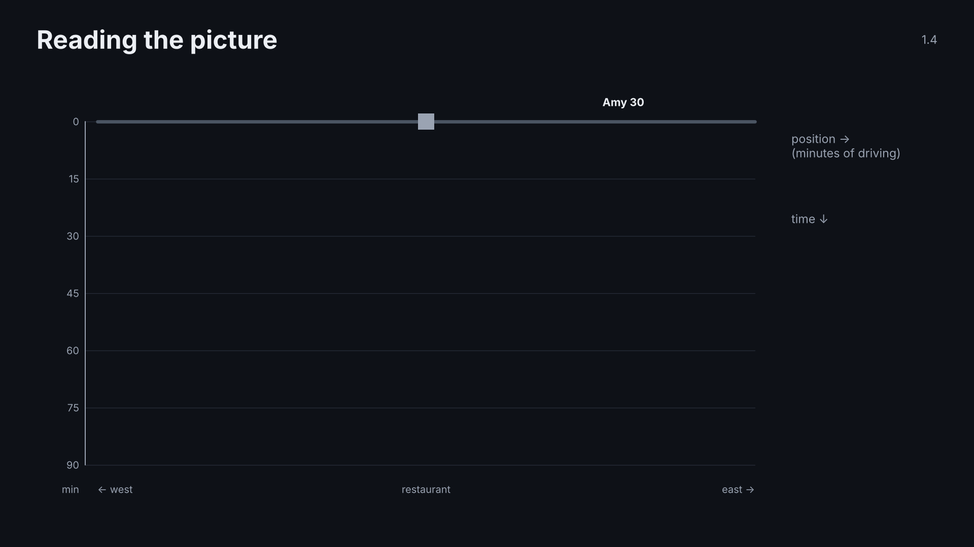
Notes:
1.4 time chart · click 2 of 5
Point: one chart shows where and when; reused for the rest of the talk.

Slide 23
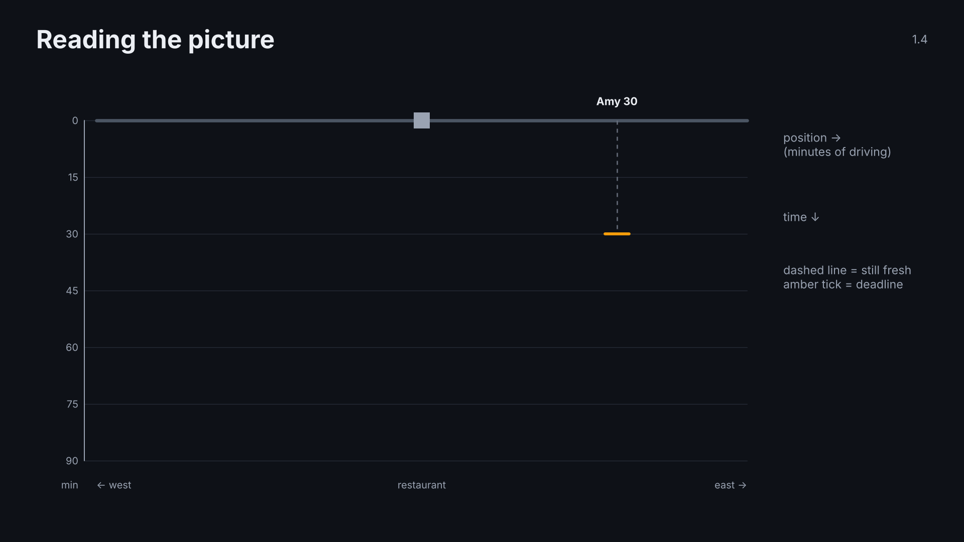
Notes:
1.4 time chart · click 3 of 5
Point: one chart shows where and when; reused for the rest of the talk.

Slide 24
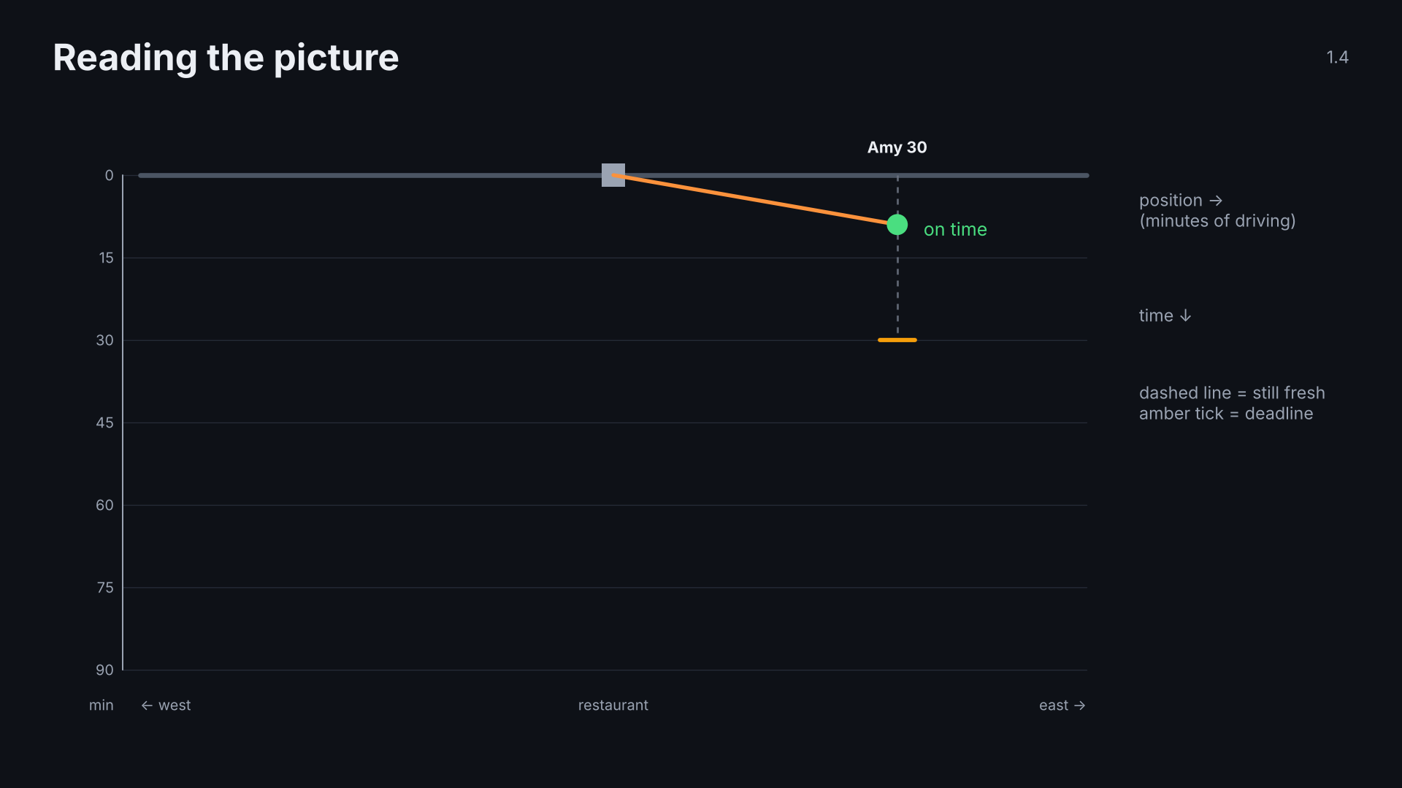
Notes:
1.4 time chart · click 4 of 5
Point: one chart shows where and when; reused for the rest of the talk.

Slide 25
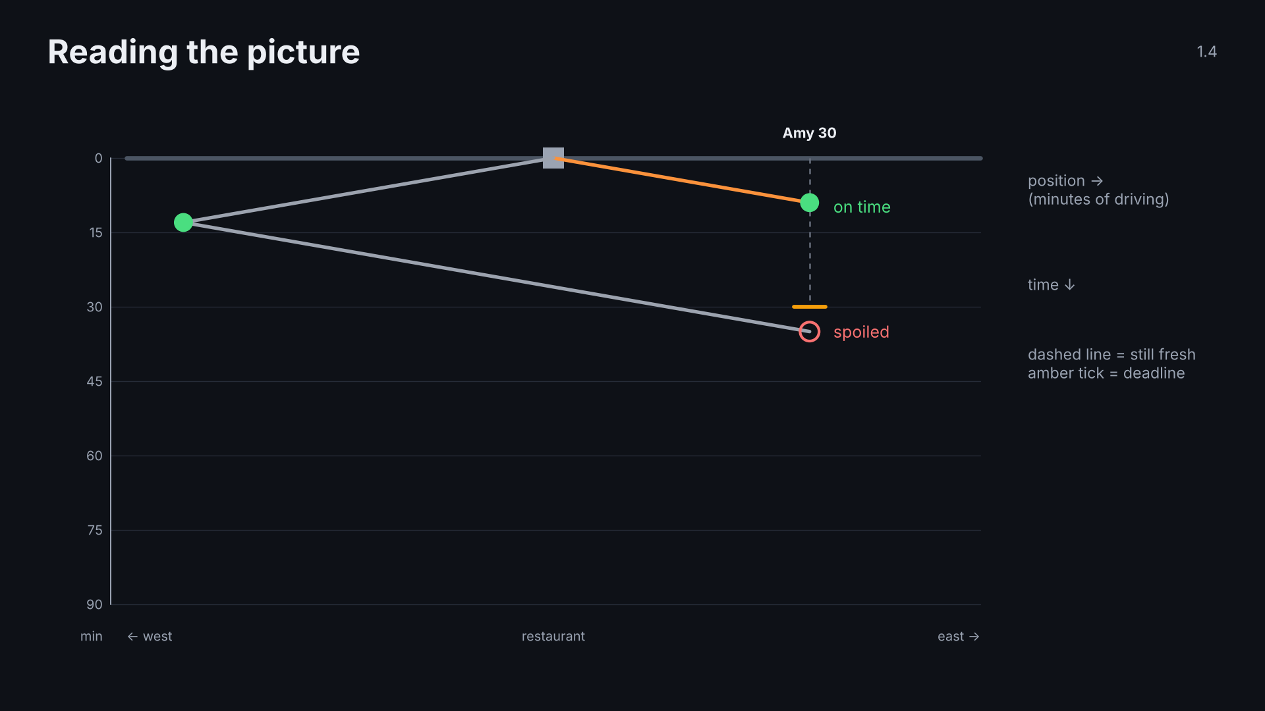
Notes:
1.4 time chart · click 5 of 5
Point: one chart shows where and when; reused for the rest of the talk.

Slide 26
Notes:
1.5 data · click 1 of 4
Point: real Kuala Lumpur locations; everything added is documented.

Slide 27
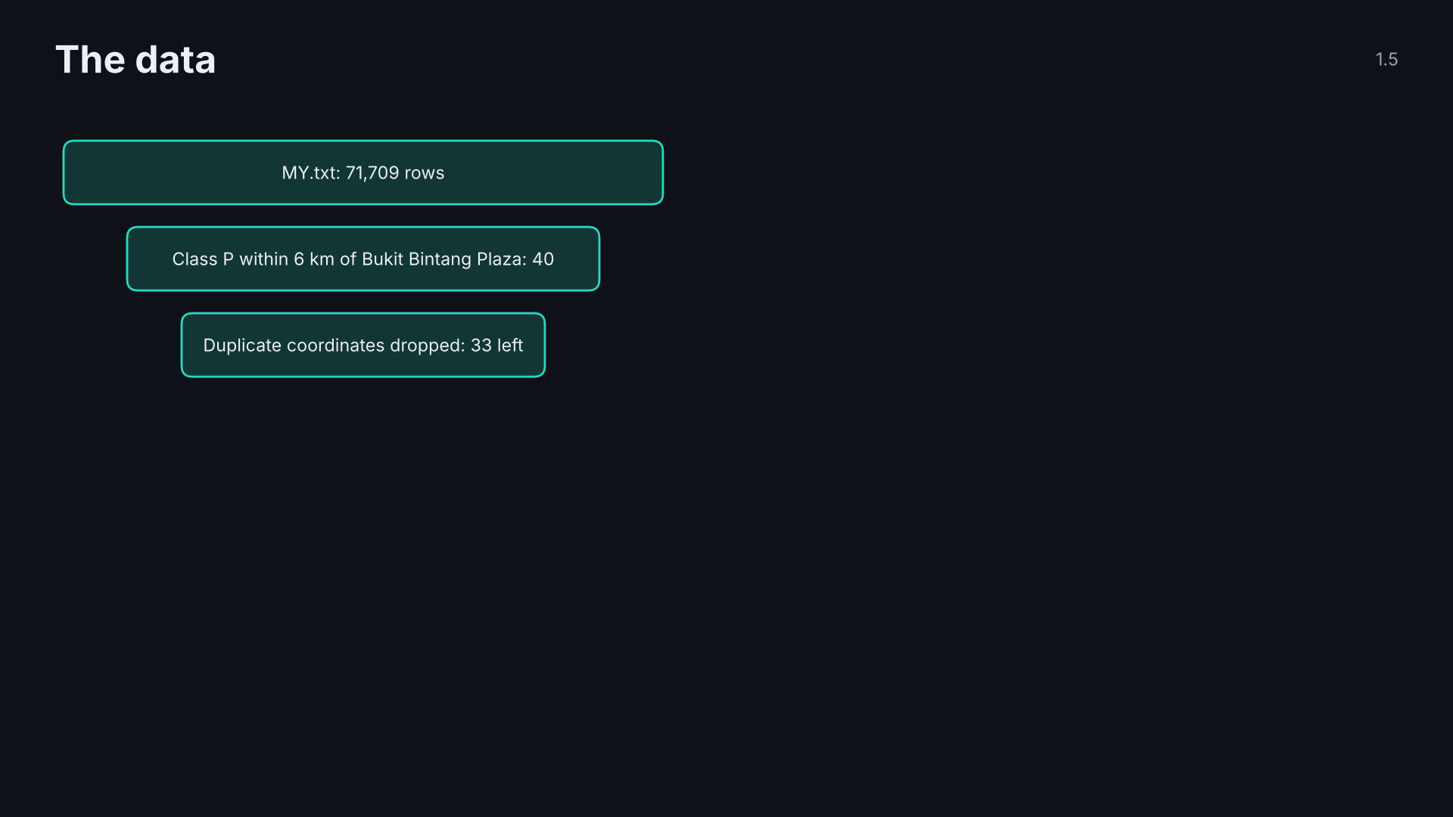
Notes:
1.5 data · click 2 of 4
Point: real Kuala Lumpur locations; everything added is documented.

Slide 28
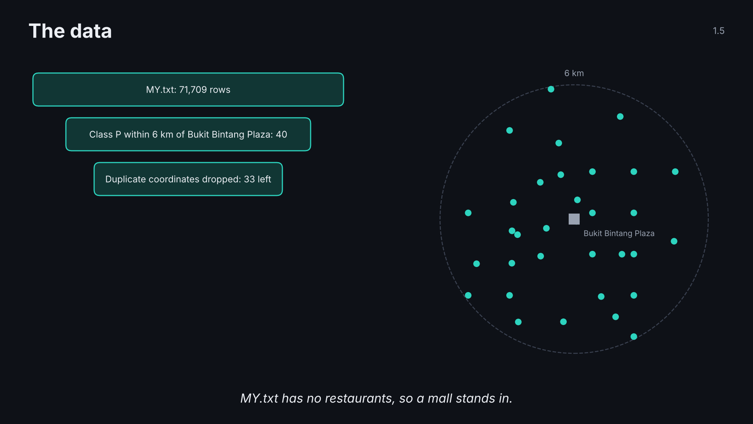
Notes:
1.5 data · click 3 of 4
Point: real Kuala Lumpur locations; everything added is documented.

Slide 29
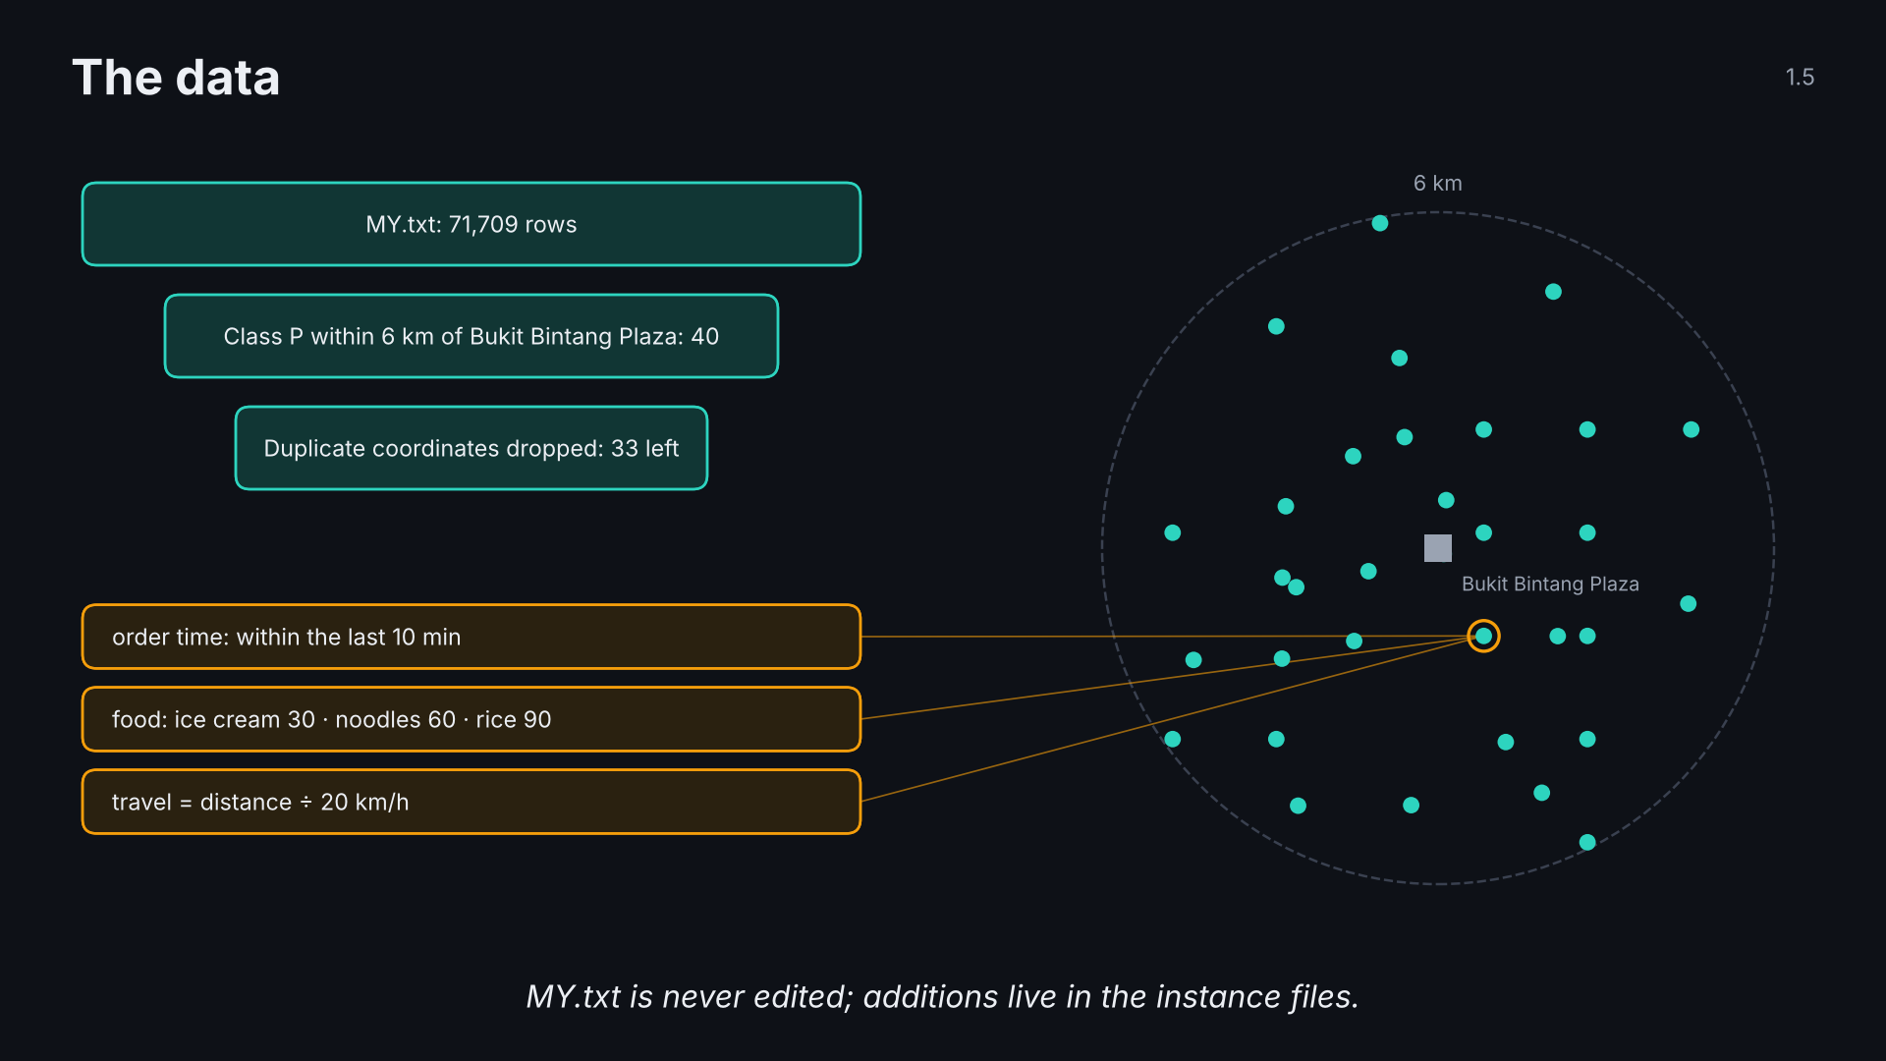
Notes:
1.5 data · click 4 of 4
Point: real Kuala Lumpur locations; everything added is documented.

Slide 30
Notes:
1.6 question · click 1 of 2
The question that sets up the two approaches.

Slide 31
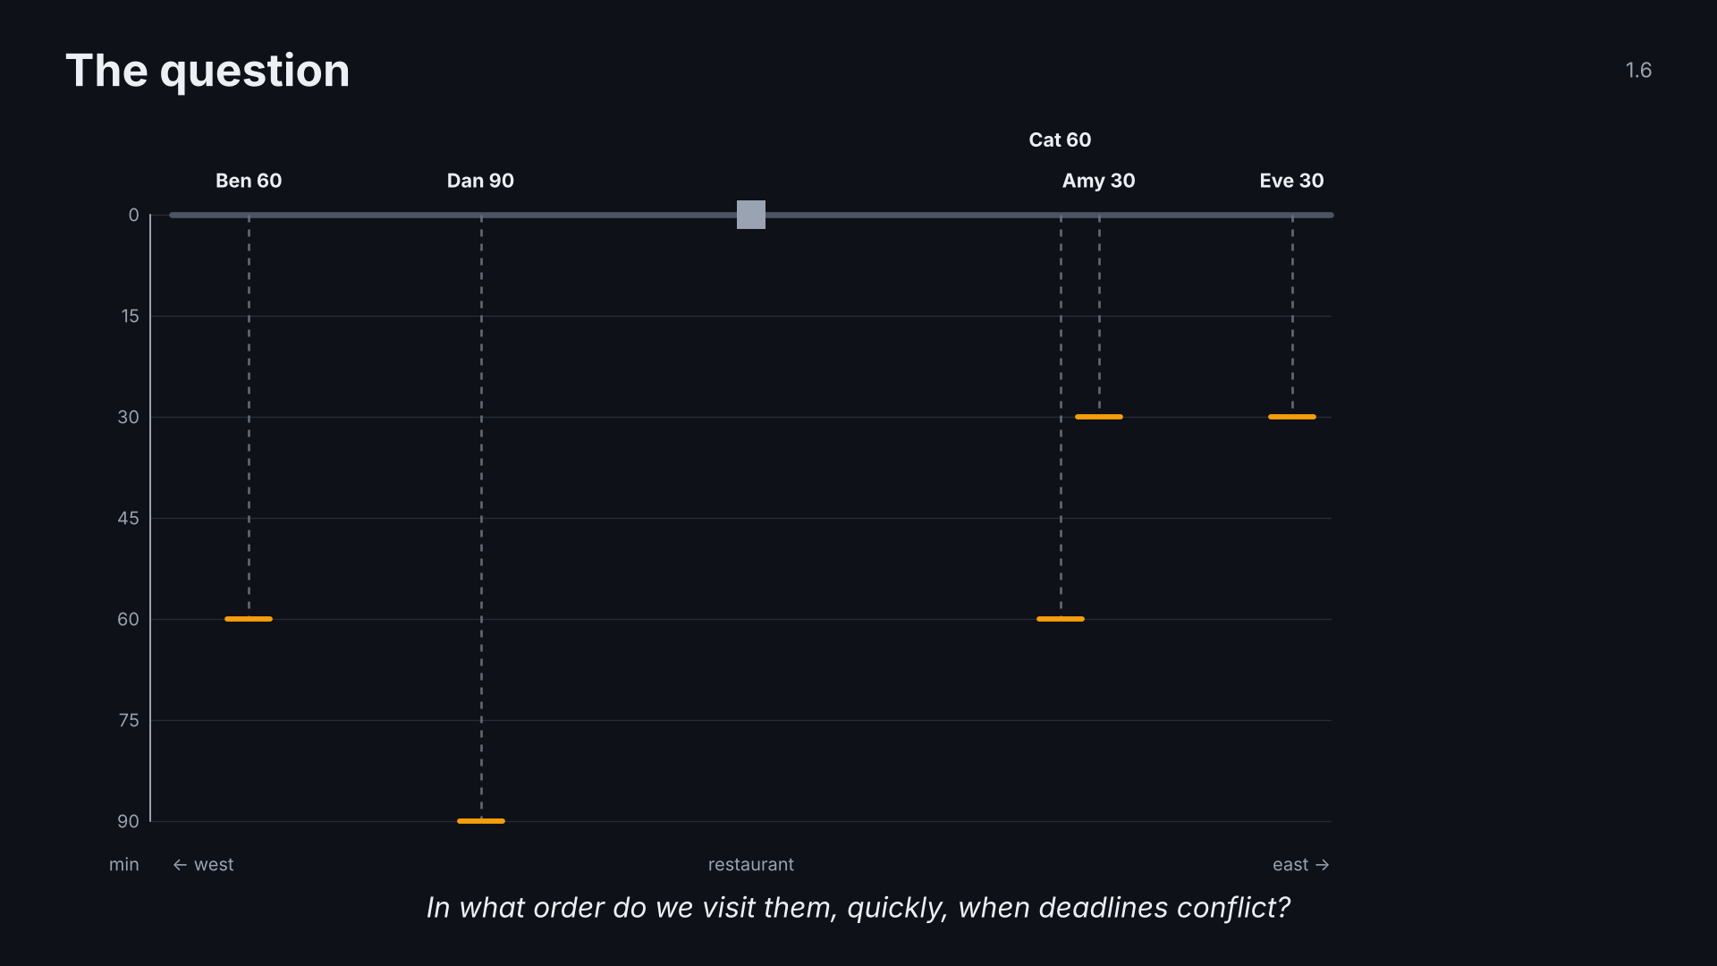
Notes:
1.6 question · click 2 of 2
The question that sets up the two approaches.

Slide 32
Notes:
2.0 section · click 1 of 1
Section 2: the two approaches.

Slide 33
Notes:
2.1 dropping is free · click 1 of 4
Point: out of reach now means out of reach forever (triangle inequality).

Slide 34
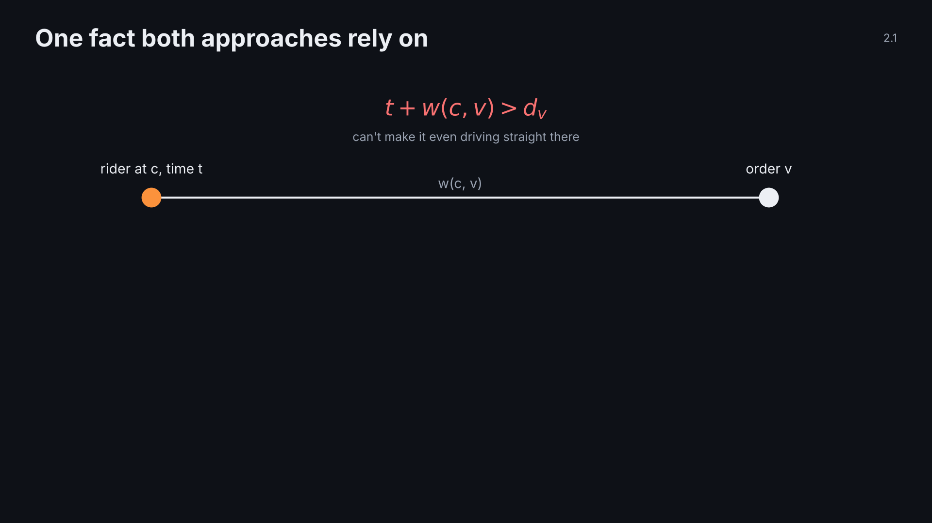
Notes:
2.1 dropping is free · click 2 of 4
Point: out of reach now means out of reach forever (triangle inequality).

Slide 35
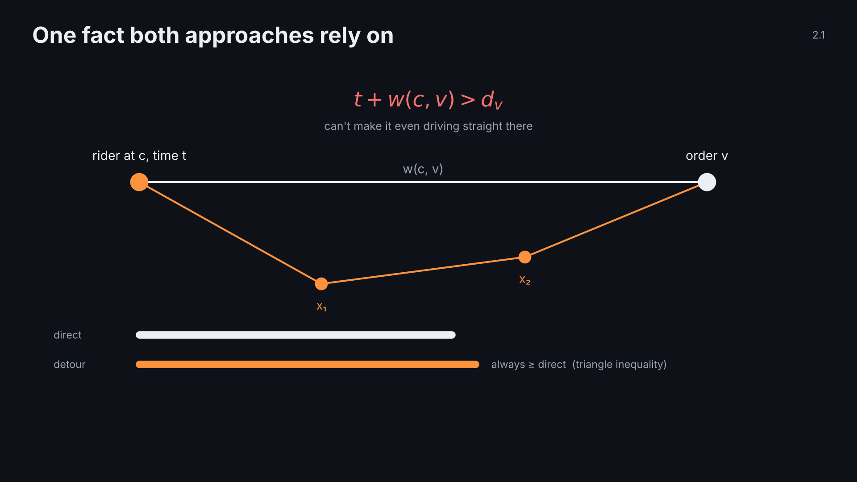
Notes:
2.1 dropping is free · click 3 of 4
Point: out of reach now means out of reach forever (triangle inequality).

Slide 36
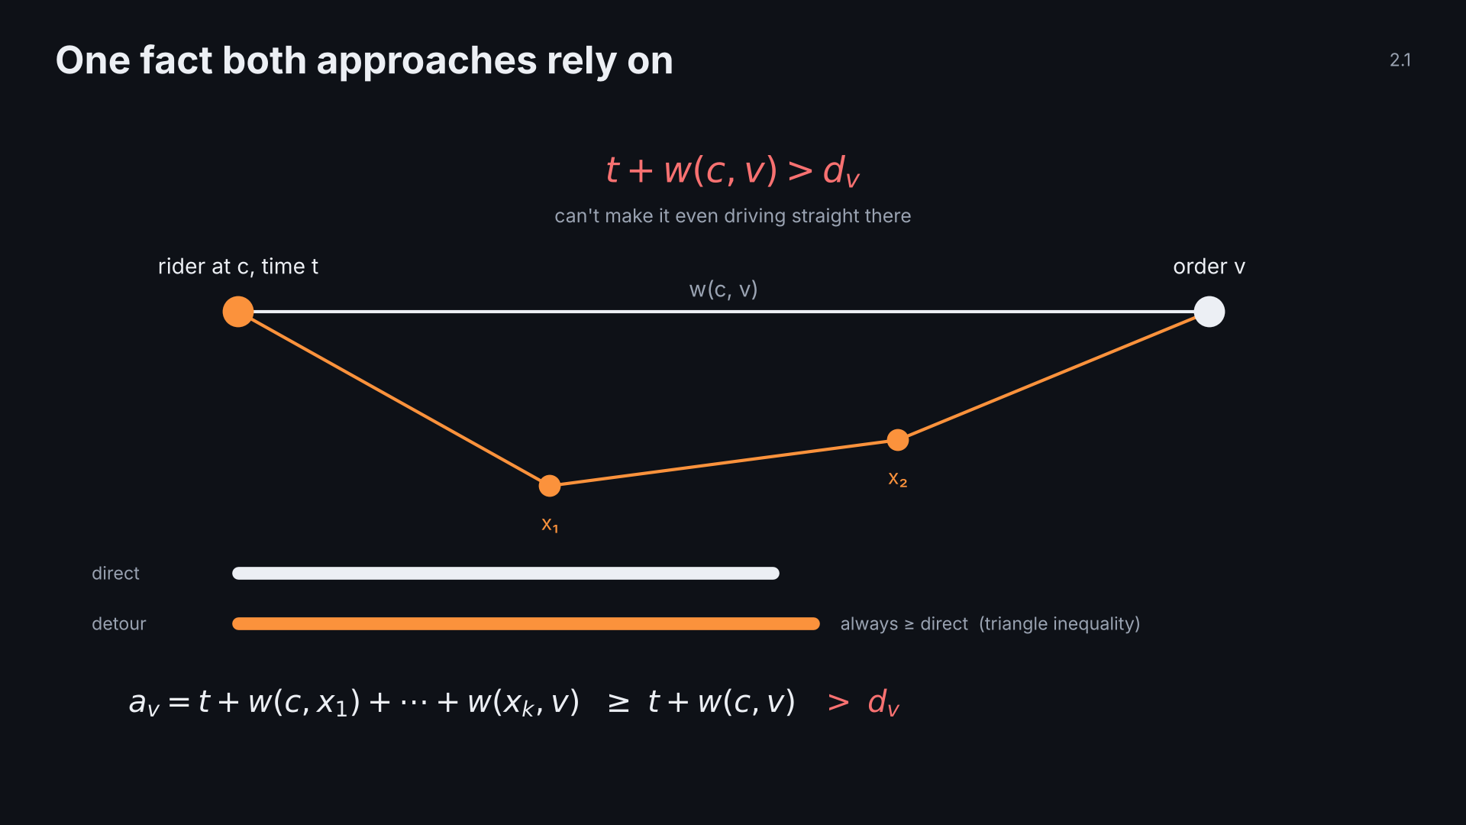
Notes:
2.1 dropping is free · click 4 of 4
Point: out of reach now means out of reach forever (triangle inequality).

Slide 37
Notes:
2.2 A plan · click 1 of 4
Point: A holds a complete plan and scores it by driving it.

Slide 38
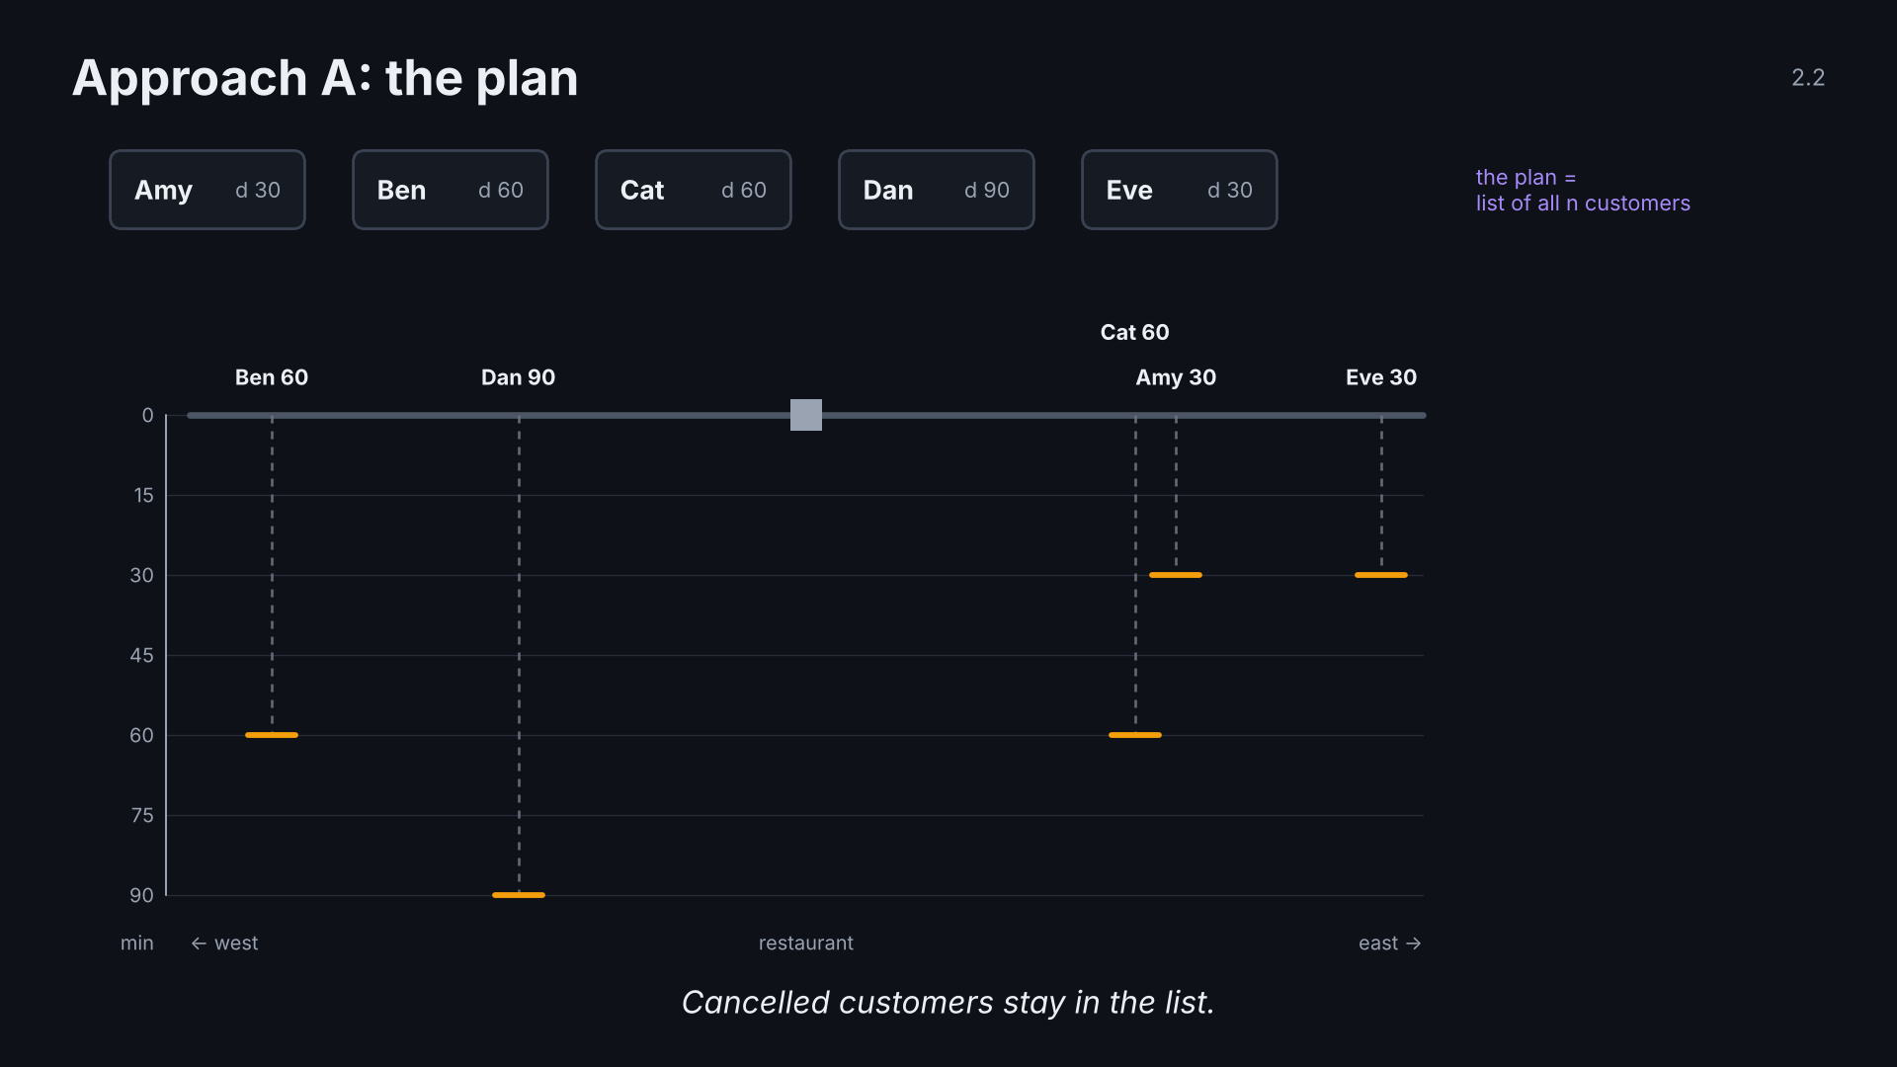
Notes:
2.2 A plan · click 2 of 4
Point: A holds a complete plan and scores it by driving it.

Slide 39
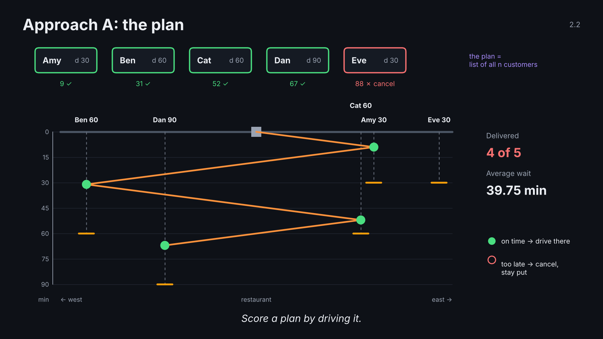
Notes:
2.2 A plan · click 3 of 4
Point: A holds a complete plan and scores it by driving it.

Slide 40
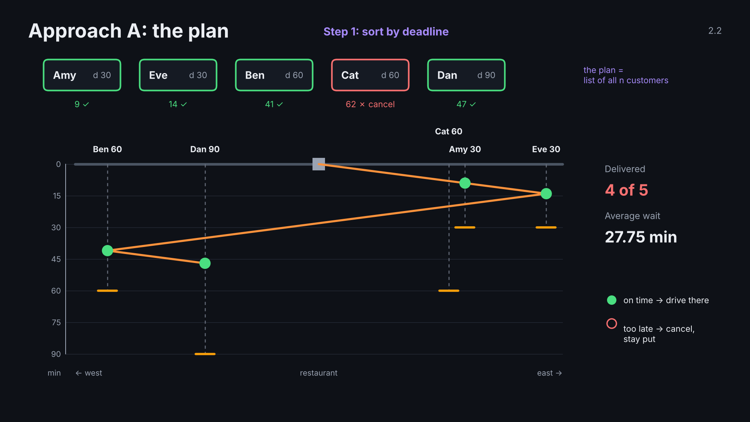
Notes:
2.2 A plan · click 4 of 4
Point: A holds a complete plan and scores it by driving it.

Slide 41
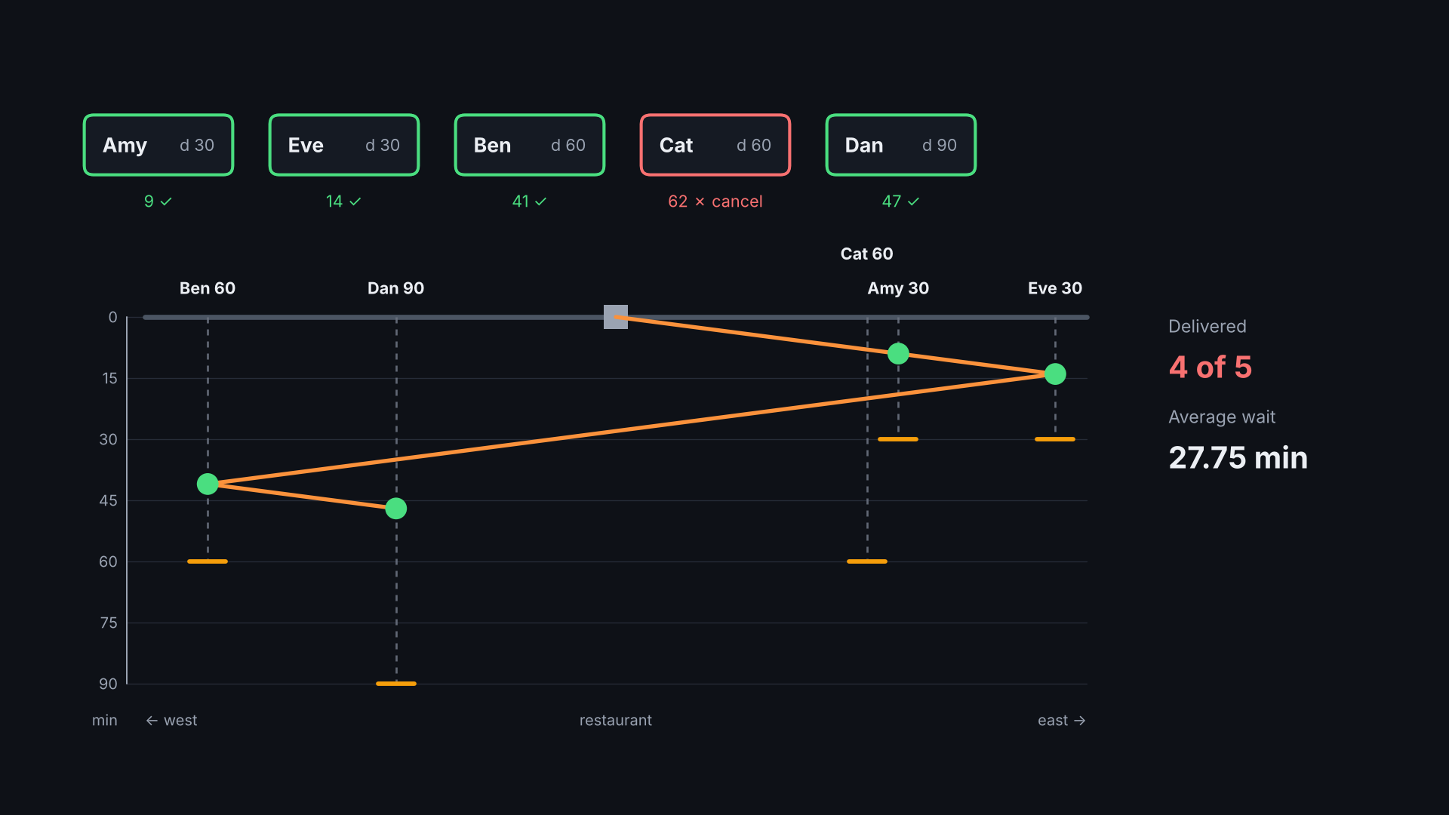
Notes:
2.3 A moves · click 1 of 5
Point: keep making the single best move until no move helps.

Slide 42
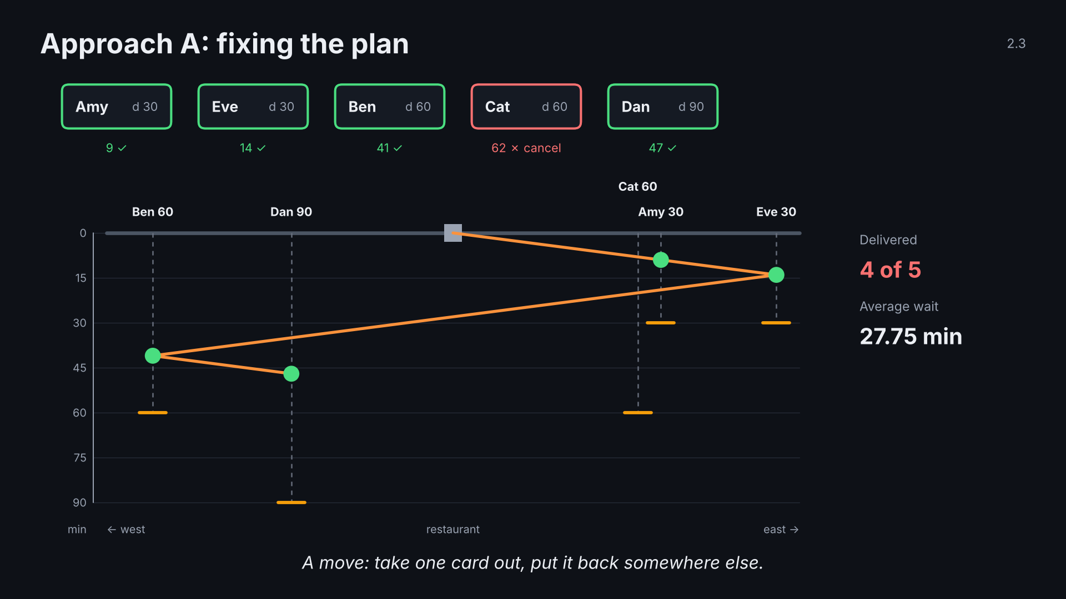
Notes:
2.3 A moves · click 2 of 5
Point: keep making the single best move until no move helps.

Slide 43
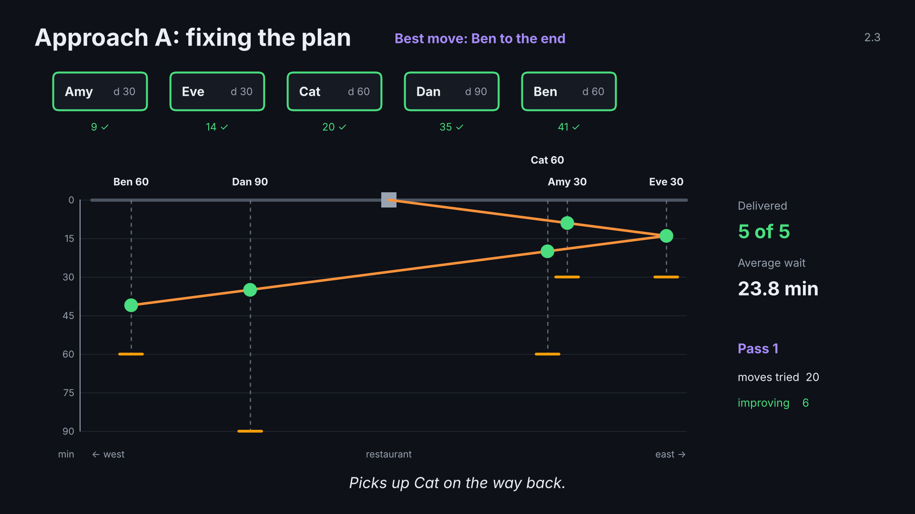
Notes:
2.3 A moves · click 3 of 5
Point: keep making the single best move until no move helps.

Slide 44
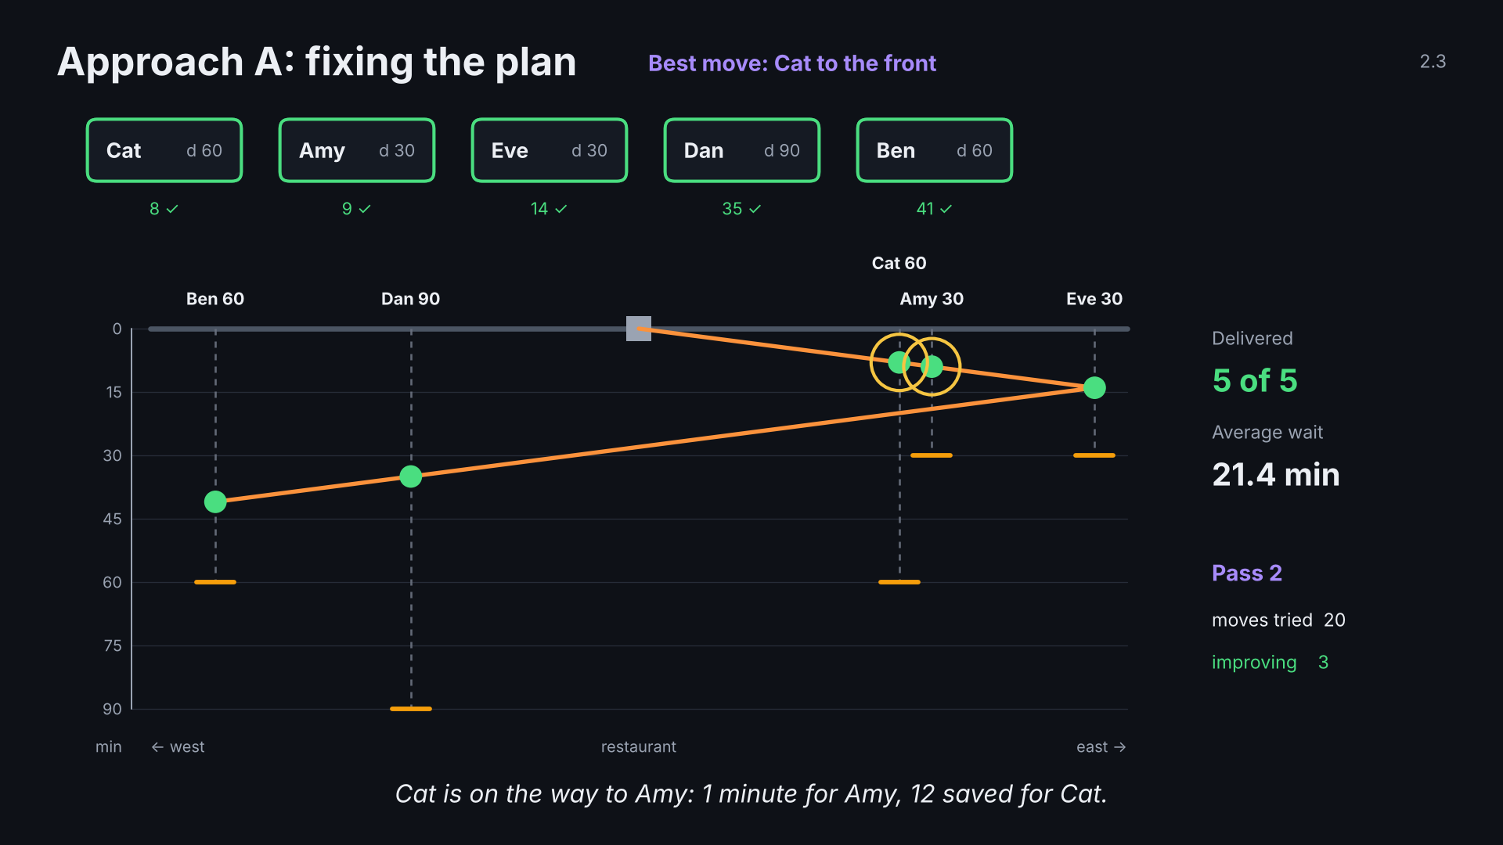
Notes:
2.3 A moves · click 4 of 5
Point: keep making the single best move until no move helps.

Slide 45
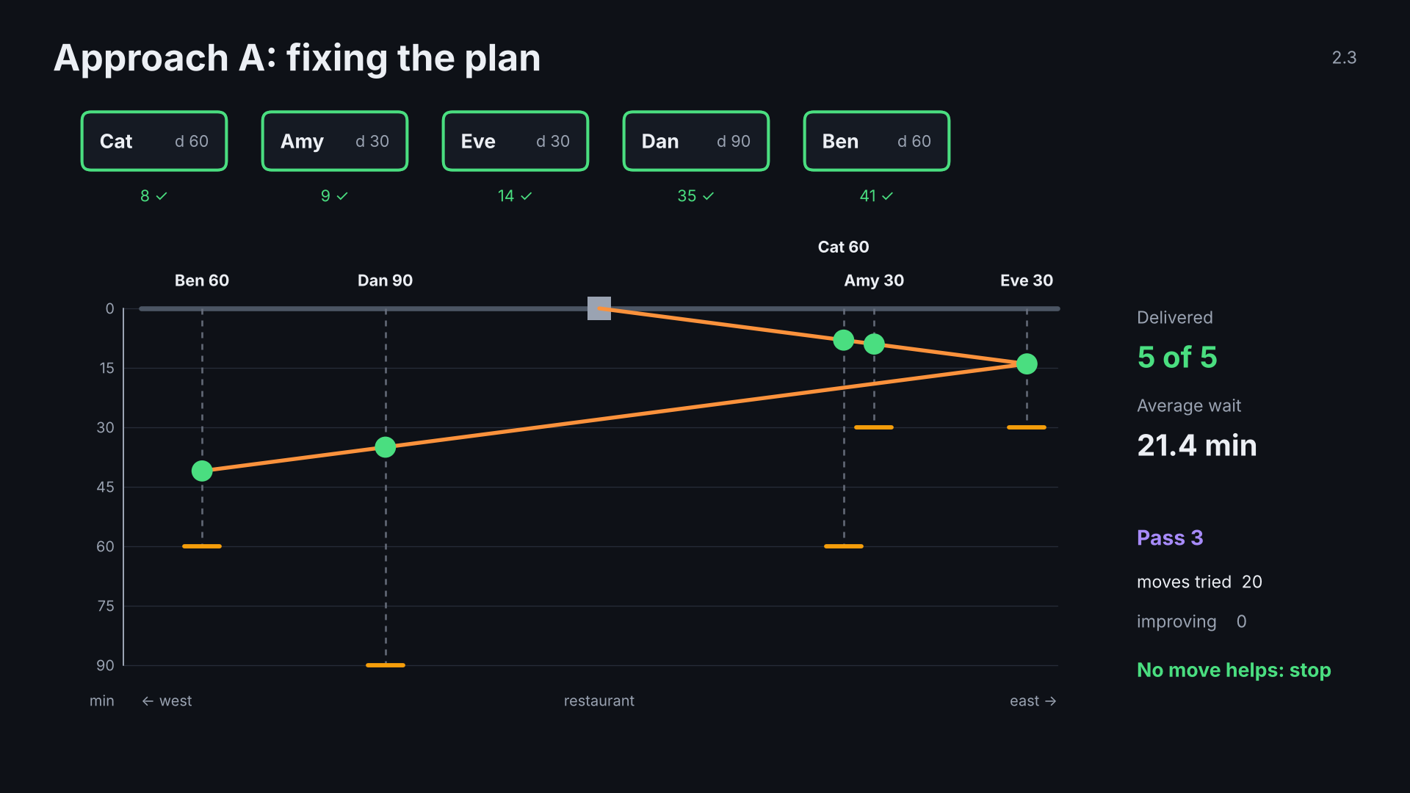
Notes:
2.3 A moves · click 5 of 5
Point: keep making the single best move until no move helps.

Slide 46
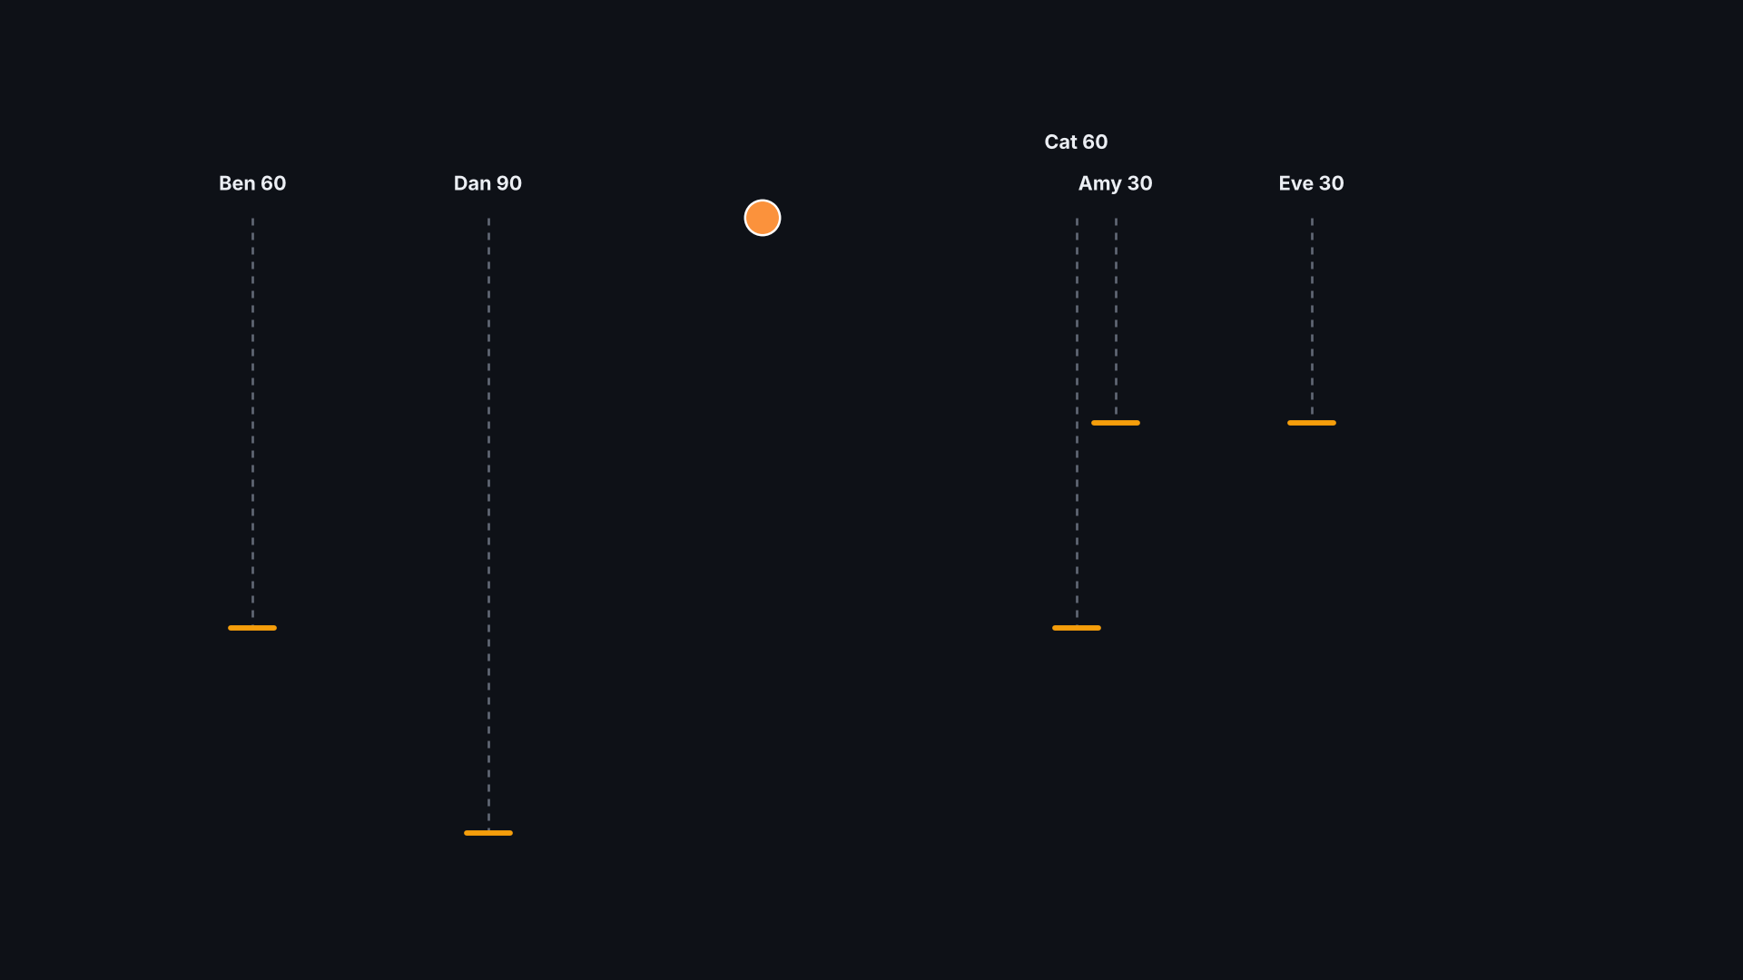
Notes:
2.4 B idea · click 1 of 3
Point: before each move, B asks how many other orders the move would doom.

Slide 47
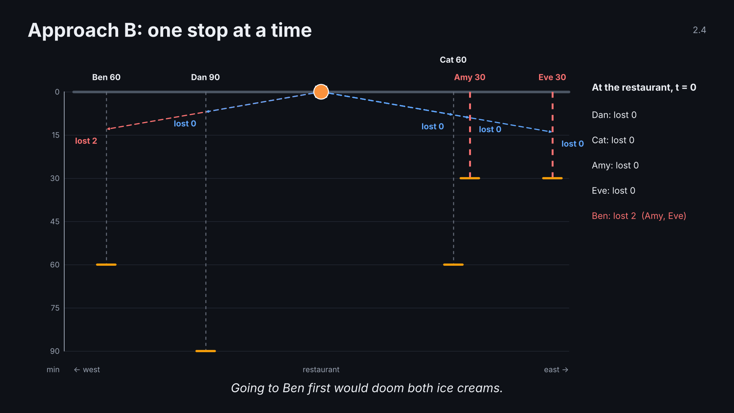
Notes:
2.4 B idea · click 2 of 3
Point: before each move, B asks how many other orders the move would doom.

Slide 48
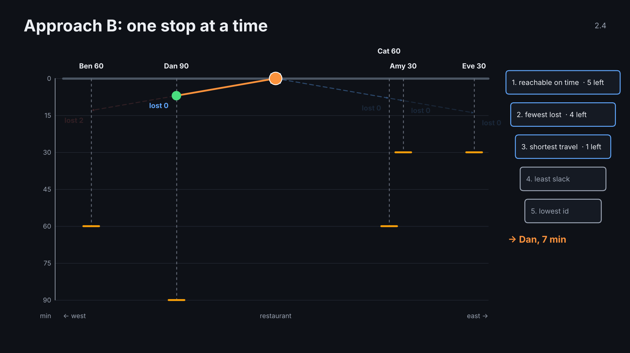
Notes:
2.4 B idea · click 3 of 3
Point: before each move, B asks how many other orders the move would doom.

Slide 49
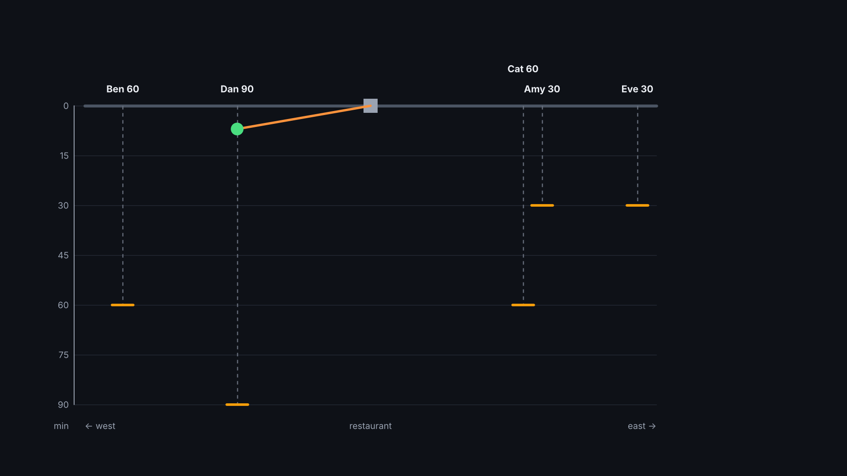
Notes:
2.5 B run · click 1 of 4
Point: B never takes a choice back.

Slide 50
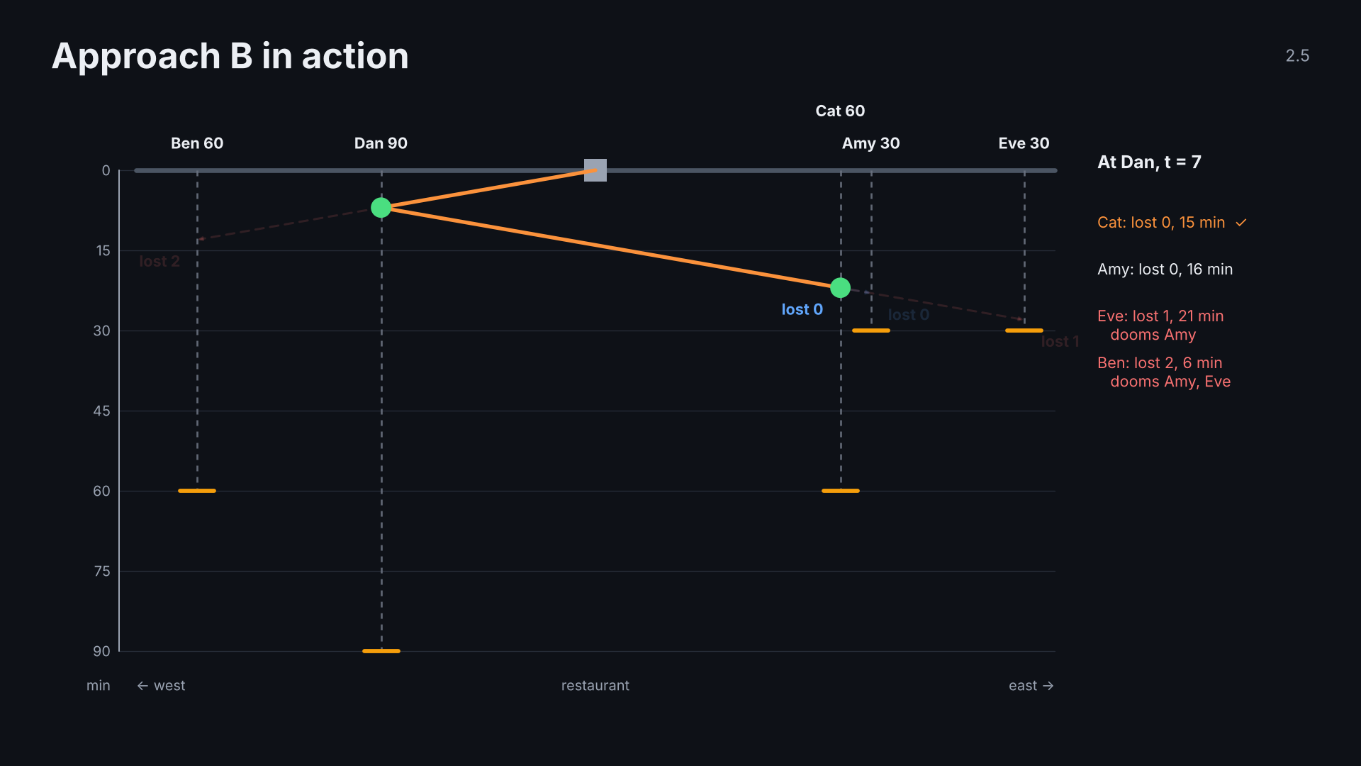
Notes:
2.5 B run · click 2 of 4
Point: B never takes a choice back.

Slide 51
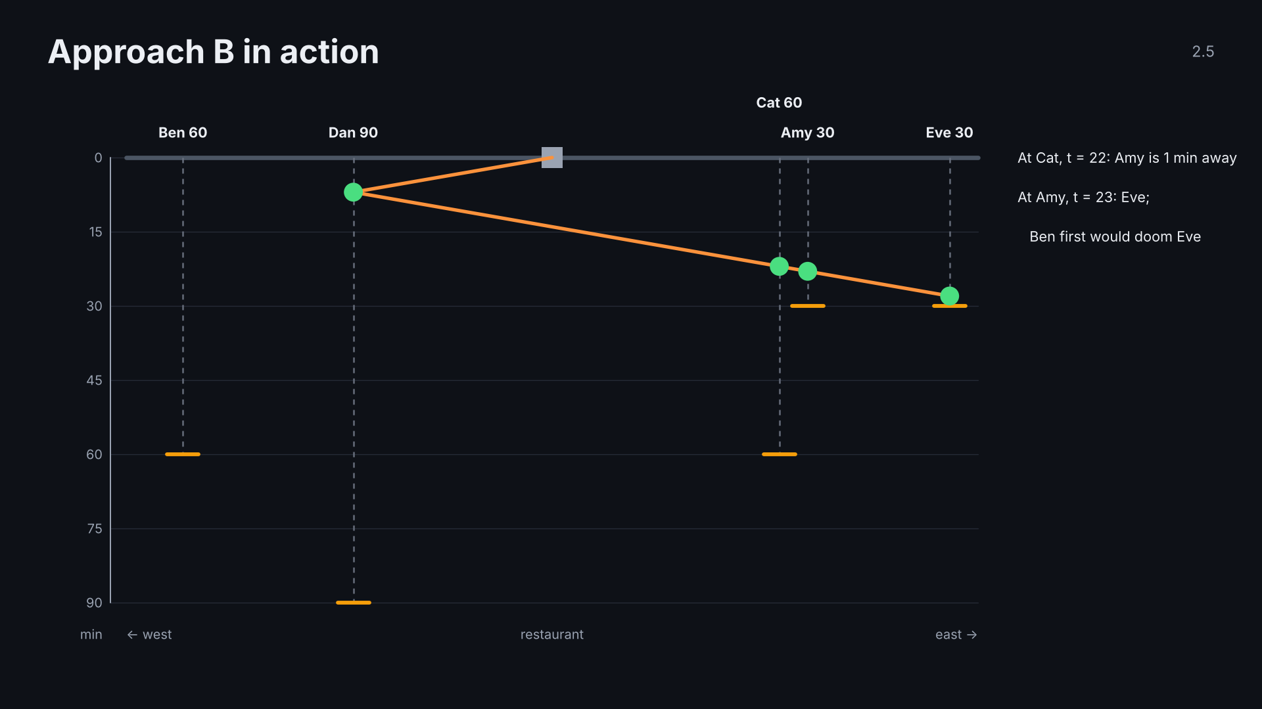
Notes:
2.5 B run · click 3 of 4
Point: B never takes a choice back.

Slide 52
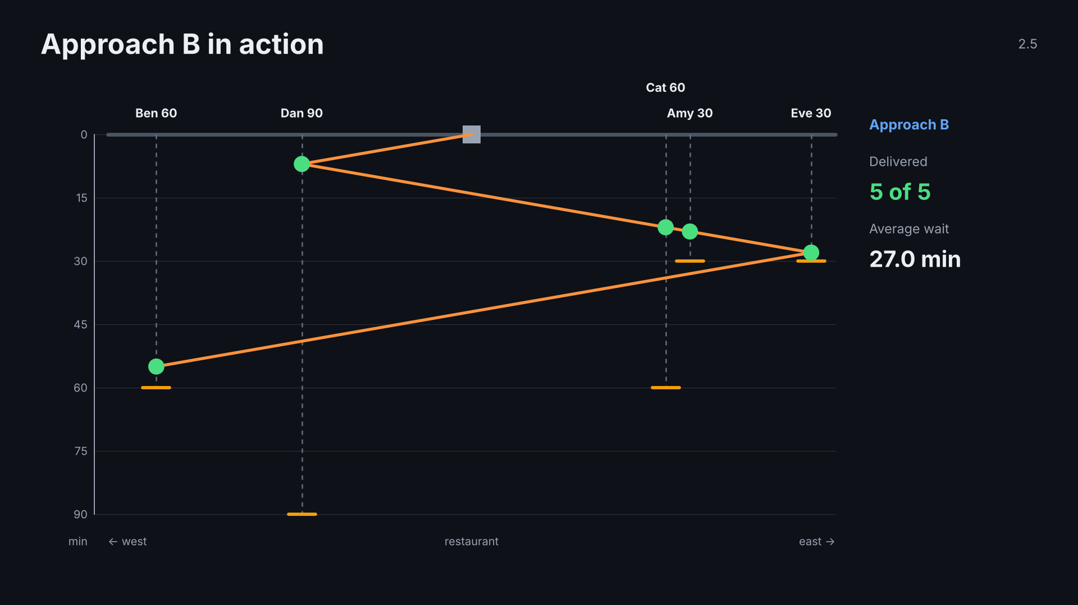
Notes:
2.5 B run · click 4 of 4
Point: B never takes a choice back.

Slide 53
Notes:
3.0 section · click 1 of 1
Section 3: evaluation.

Slide 54
Notes:
3.1 head to head · click 1 of 3
Point: on this example Approach A finds the true best.

Slide 55
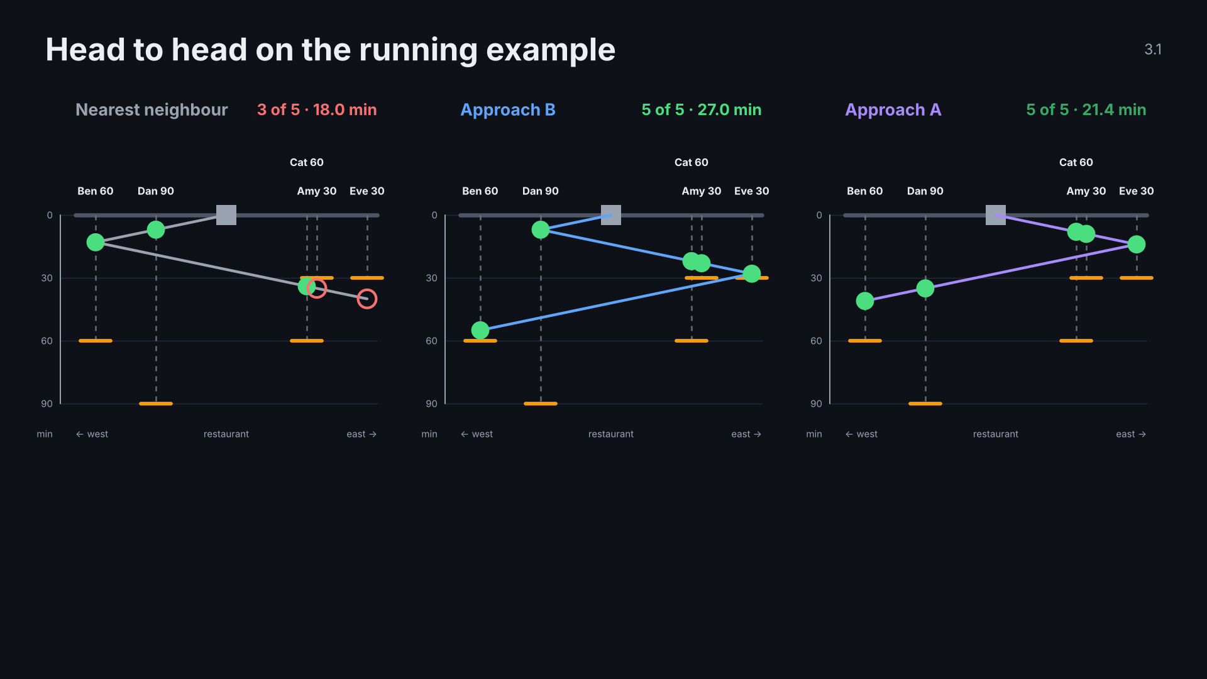
Notes:
3.1 head to head · click 2 of 3
Point: on this example Approach A finds the true best.

Slide 56
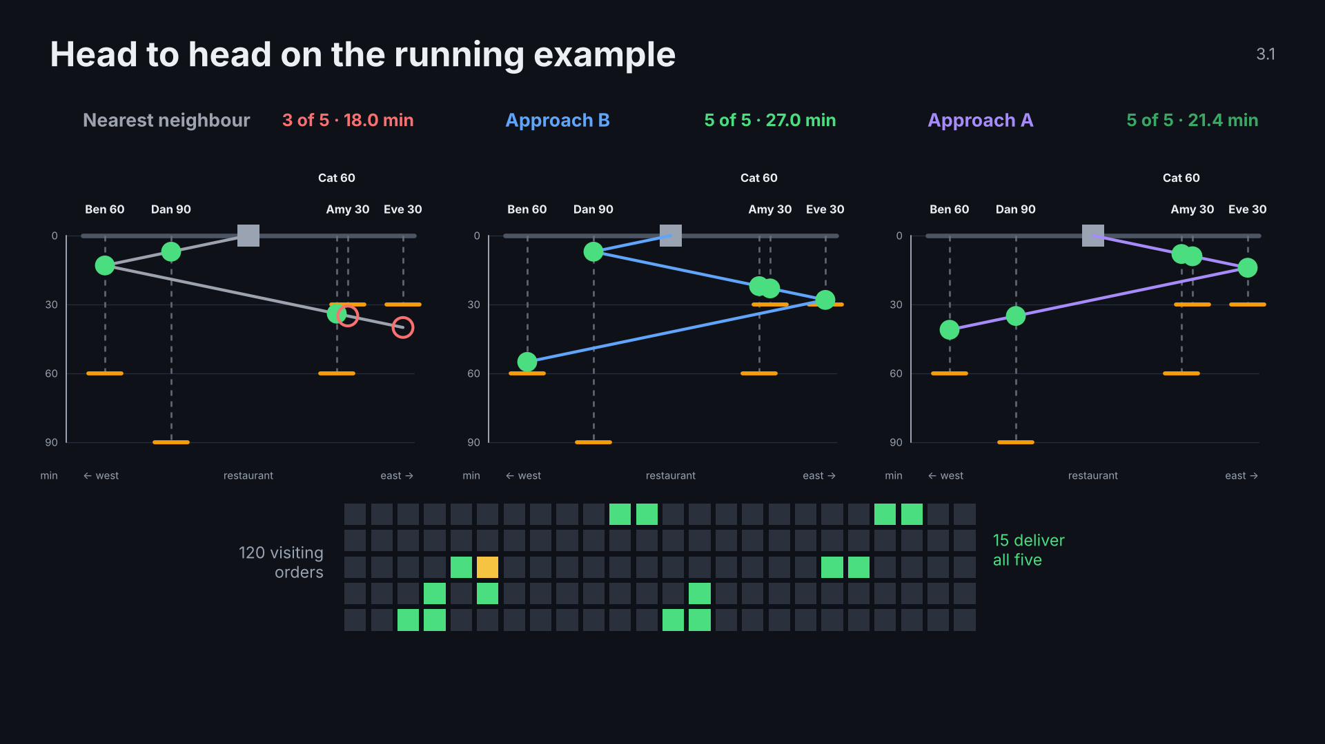
Notes:
3.1 head to head · click 3 of 3
Point: on this example Approach A finds the true best.

Slide 57
Notes:
3.2 traps · click 1 of 5
Point: the two approaches fail on opposite structures.

Slide 58
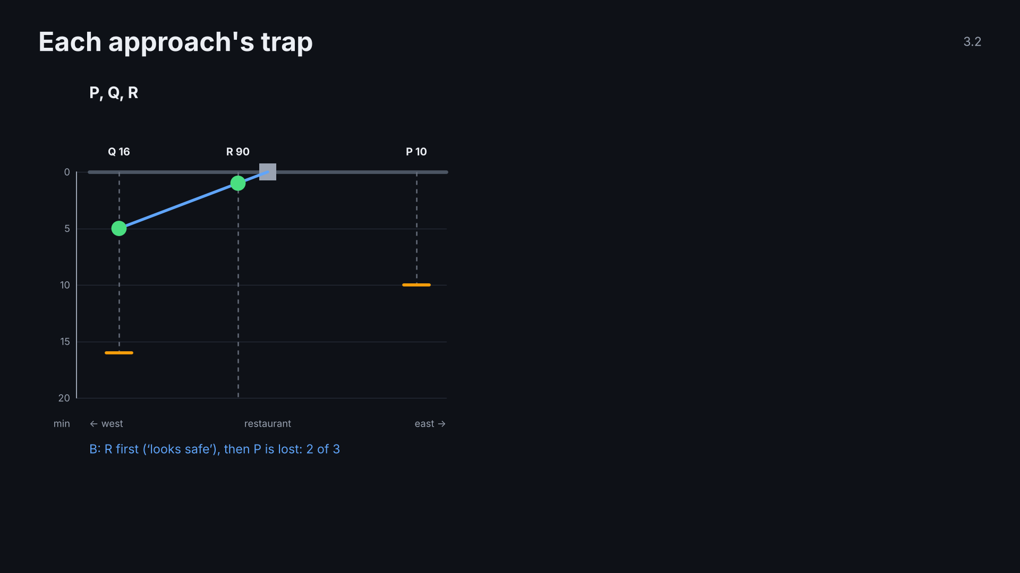
Notes:
3.2 traps · click 2 of 5
Point: the two approaches fail on opposite structures.

Slide 59
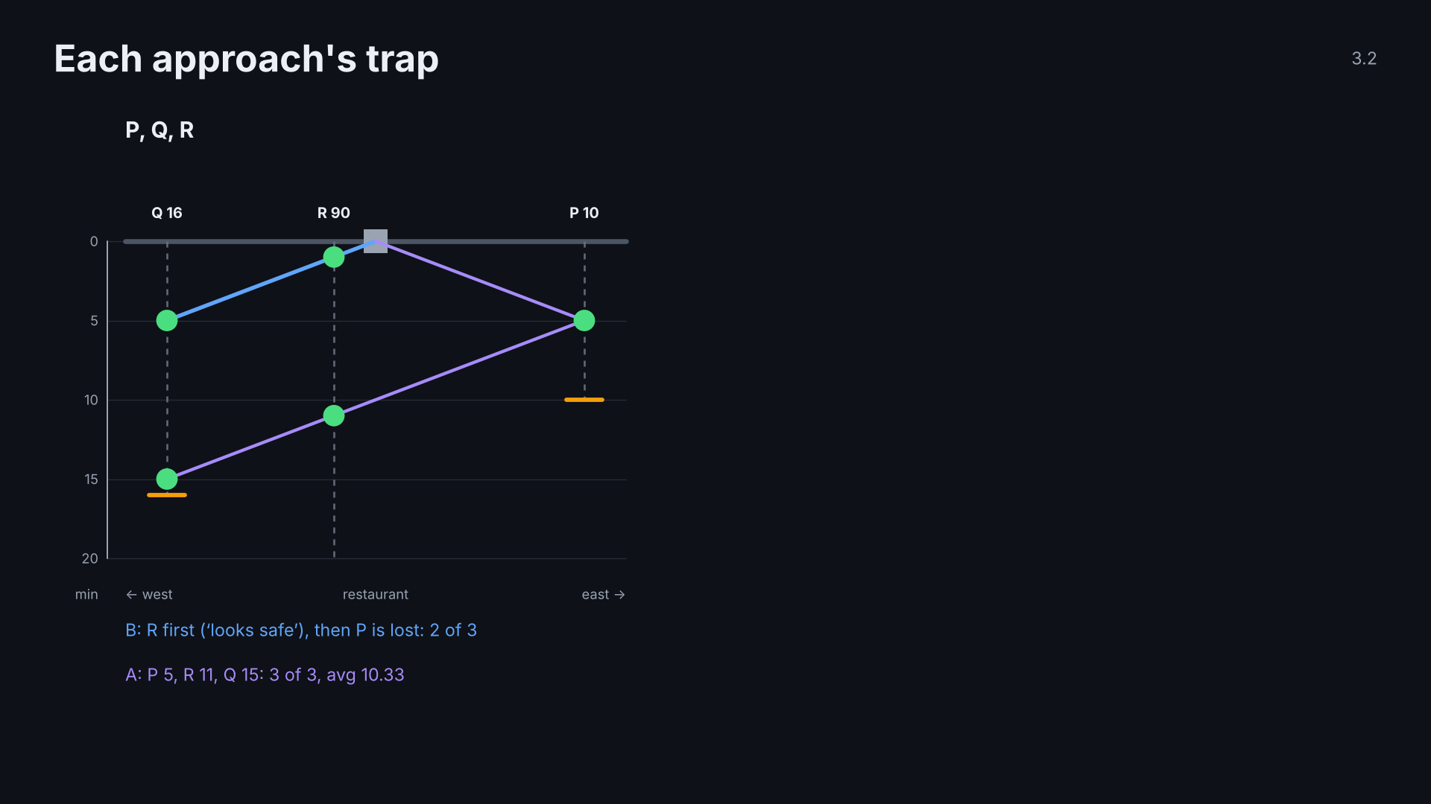
Notes:
3.2 traps · click 3 of 5
Point: the two approaches fail on opposite structures.

Slide 60
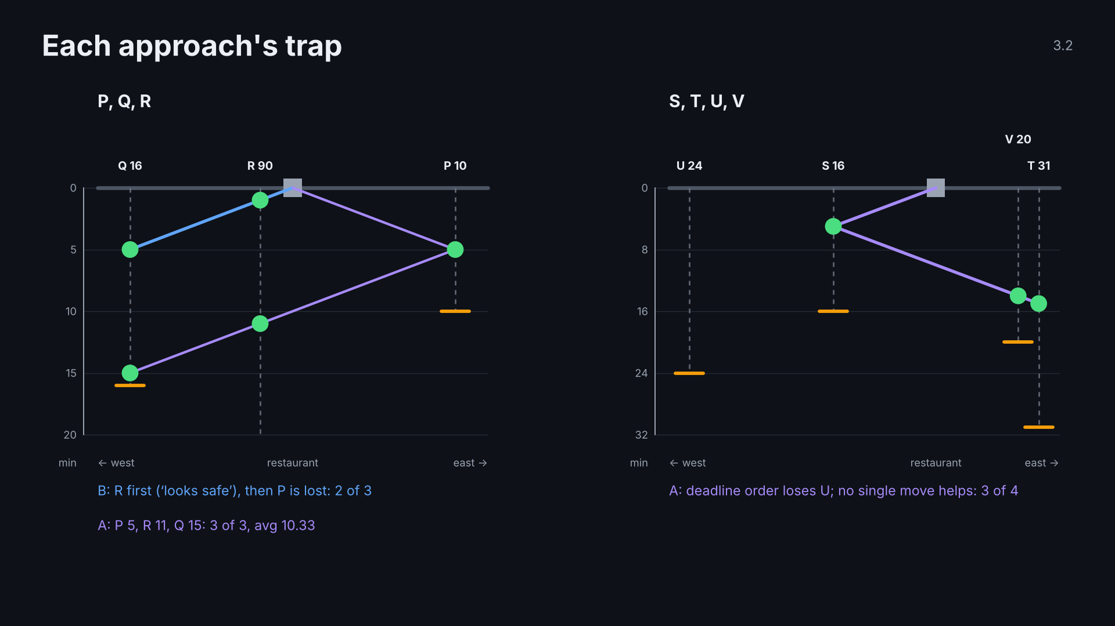
Notes:
3.2 traps · click 4 of 5
Point: the two approaches fail on opposite structures.

Slide 61
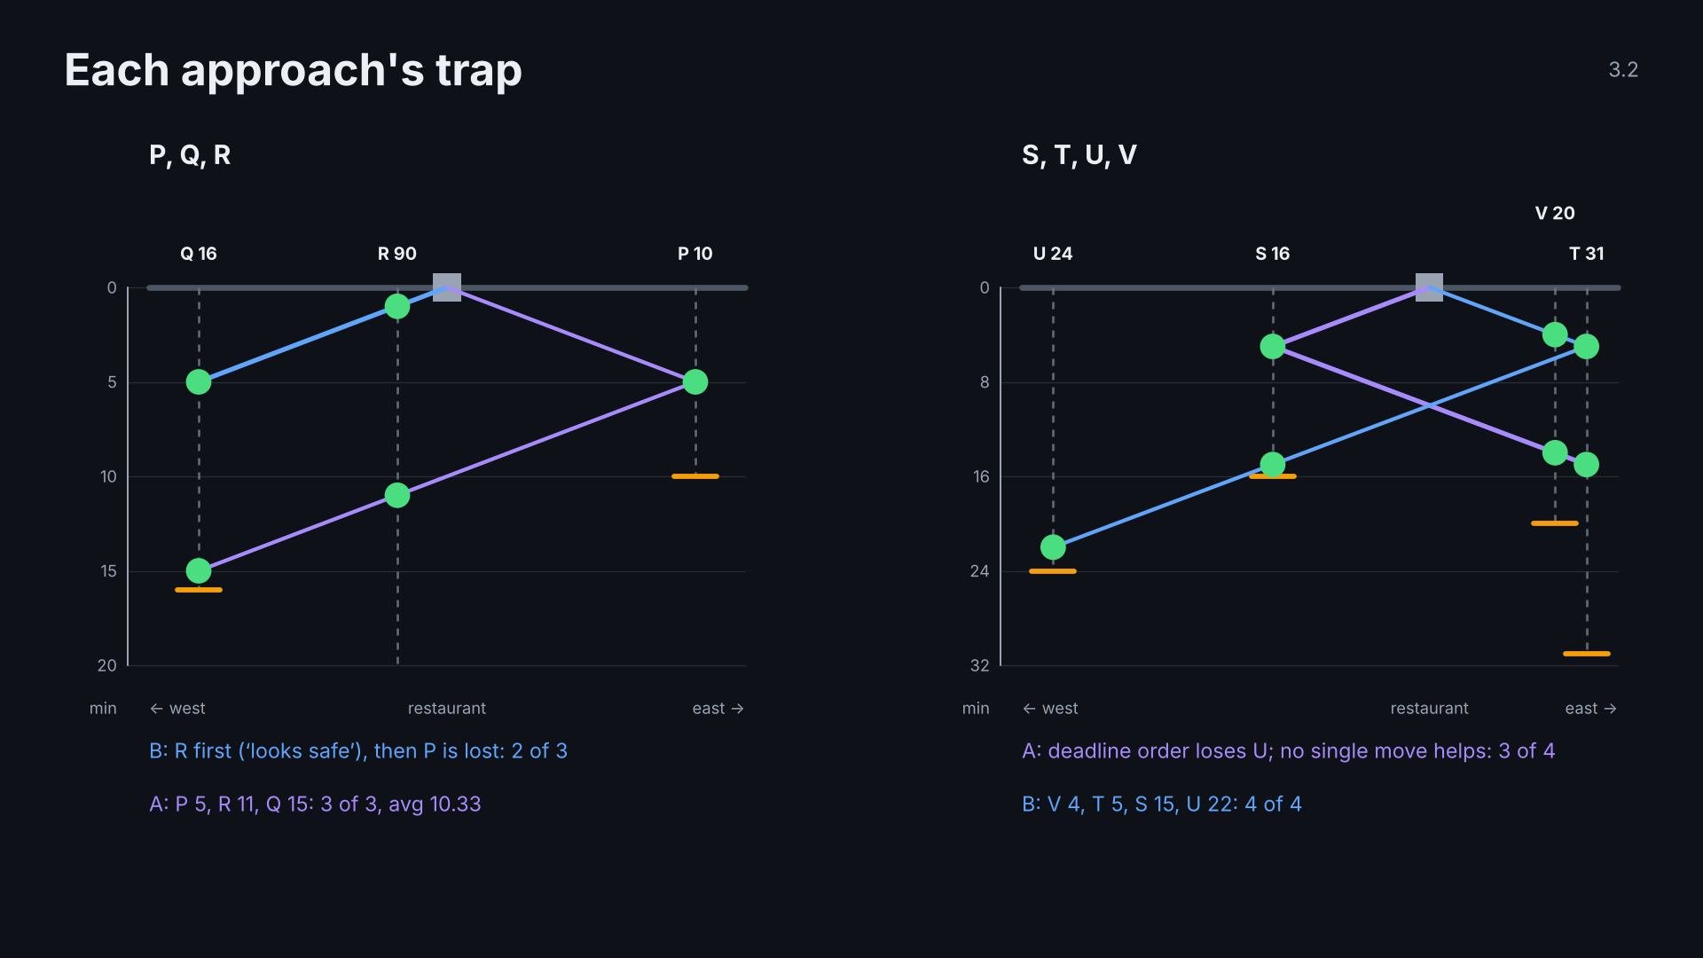
Notes:
3.2 traps · click 5 of 5
Point: the two approaches fail on opposite structures.

Slide 62
Notes:
3.3 results cancelled · click 1 of 3
TODO: fill from results/summary.csv after the shared-instance runs.

Slide 63
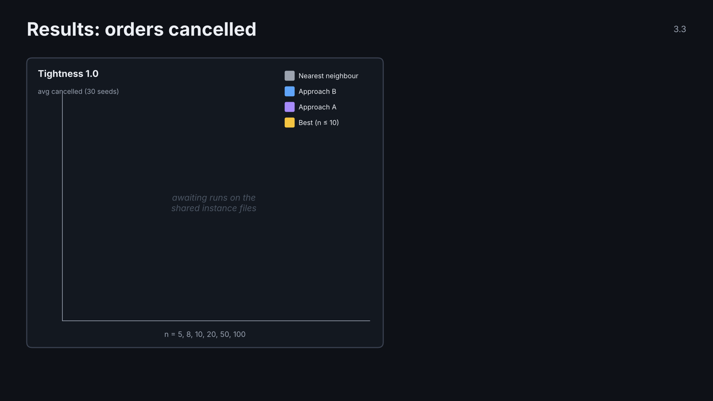
Notes:
3.3 results cancelled · click 2 of 3
TODO: fill from results/summary.csv after the shared-instance runs.

Slide 64
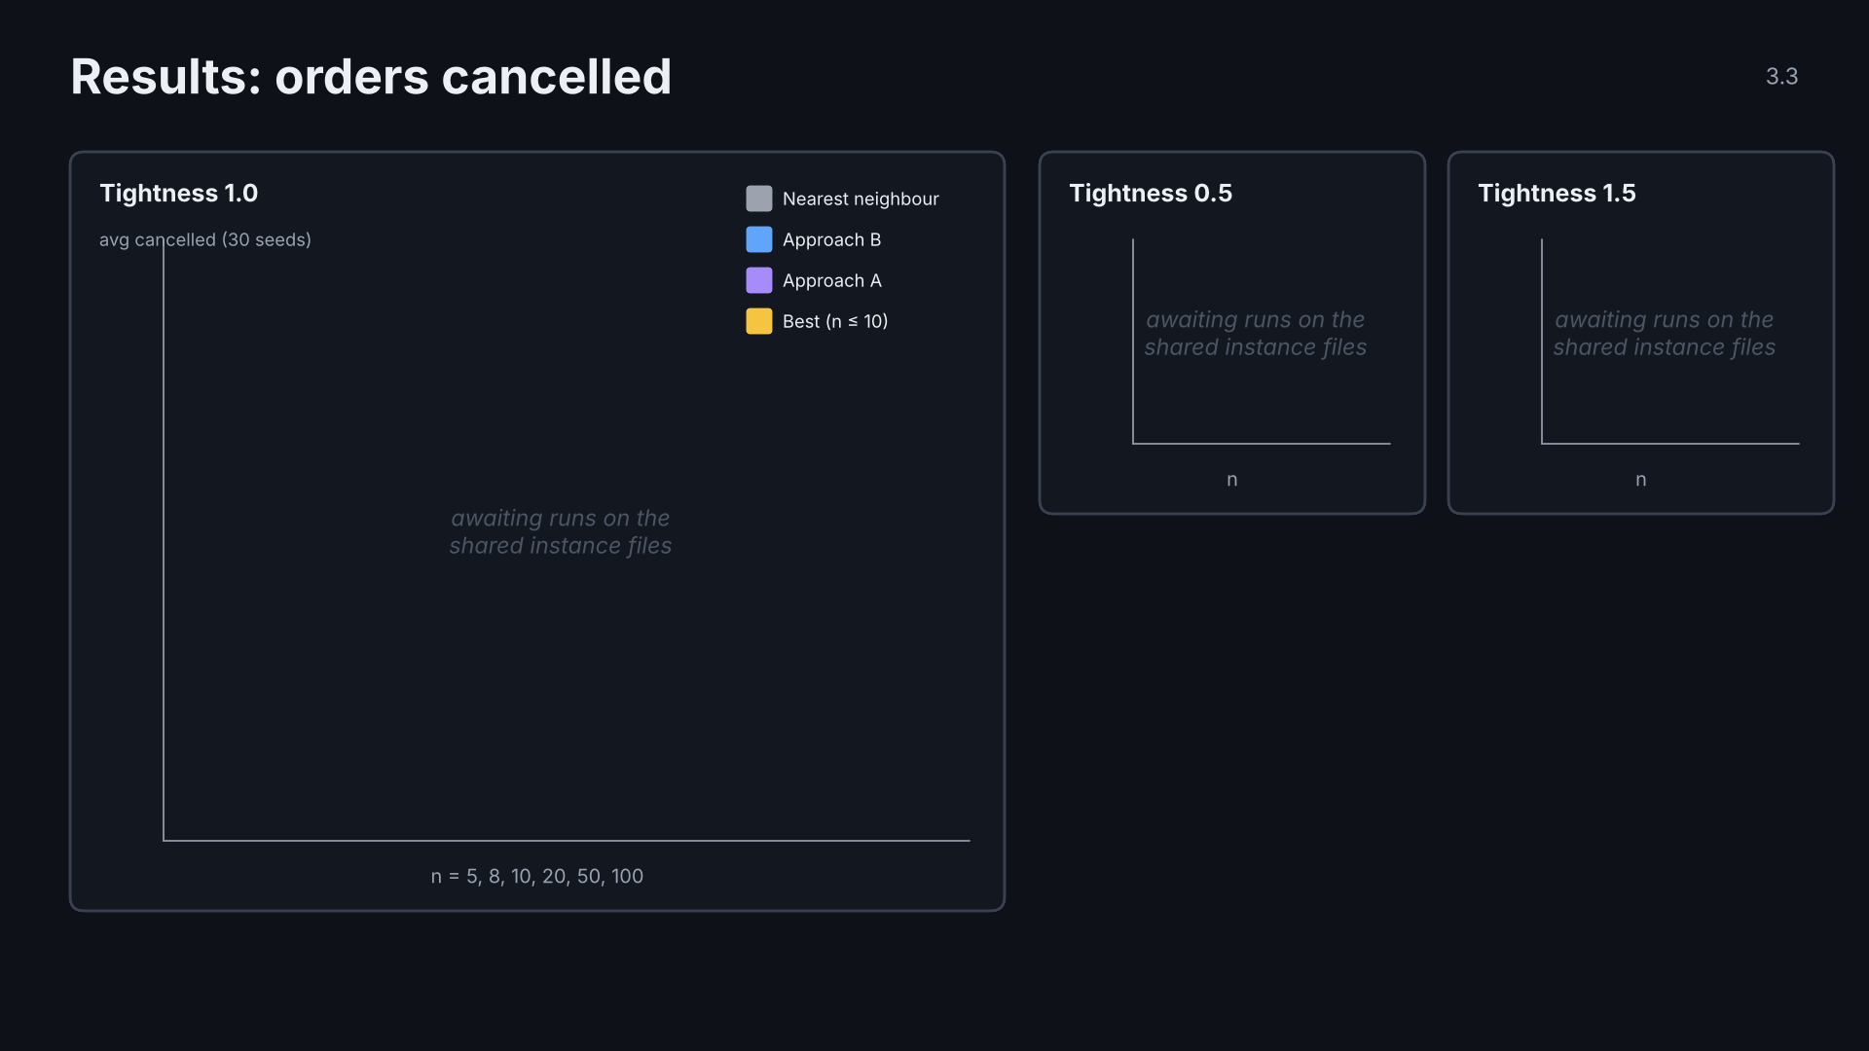
Notes:
3.3 results cancelled · click 3 of 3
TODO: fill from results/summary.csv after the shared-instance runs.

Slide 65
Notes:
3.4 results speed · click 1 of 2
TODO: fill run times after the shared-instance runs.

Slide 66

Notes:
3.4 results speed · click 2 of 2
TODO: fill run times after the shared-instance runs.

Slide 67
Notes:
3.5 tradeoffs · click 1 of 6
One row per click.

Slide 68

Notes:
3.5 tradeoffs · click 2 of 6
One row per click.

Slide 69

Notes:
3.5 tradeoffs · click 3 of 6
One row per click.

Slide 70

Notes:
3.5 tradeoffs · click 4 of 6
One row per click.

Slide 71

Notes:
3.5 tradeoffs · click 5 of 6
One row per click.

Slide 72

Notes:
3.5 tradeoffs · click 6 of 6
One row per click.

Slide 73
Notes:
4.0 section · click 1 of 1
Section 4: wrap-up.

Slide 74
Notes:
4.1 recap · click 1 of 1
Recap in one picture.

Slide 75
Notes:
4.2 Limits and next steps · click 1 of 3

Slide 76

Notes:
4.2 Limits and next steps · click 2 of 3

Slide 77

Notes:
4.2 Limits and next steps · click 3 of 3

Slide 78
Notes:
4.3 What makes this stand out · click 1 of 3

Slide 79

Notes:
4.3 What makes this stand out · click 2 of 3

Slide 80

Notes:
4.3 What makes this stand out · click 3 of 3

Slide 81
Notes:
4.4 AI usage · click 1 of 2
Required by the brief, section 11.3. Fill in before presenting.

Slide 82

Notes:
4.4 AI usage · click 2 of 2
Required by the brief, section 11.3. Fill in before presenting.

Slide 83
Notes:
4.5 closing · click 1 of 1
Thank the audience; take questions. Appendix follows.

Slide 84
Notes:
A.1 V2 example · click 1 of 3
Backup. Numbers are from the group template's worked example (n = 6, seed 10).

Slide 85

Notes:
A.1 V2 example · click 2 of 3
Backup. Numbers are from the group template's worked example (n = 6, seed 10).

Slide 86

Notes:
A.1 V2 example · click 3 of 3
Backup. Numbers are from the group template's worked example (n = 6, seed 10).

Slide 87
Notes:
A.2 passes · click 1 of 2
Backup. TODO: fill from the real runs.

Slide 88

Notes:
A.2 passes · click 2 of 2
Backup. TODO: fill from the real runs.

Slide 89

Notes:
A.3 no heap · click 1 of 2
Backup: why B uses a linear scan, and why A only sorts once.

Slide 90

Notes:
A.3 no heap · click 2 of 2
Backup: why B uses a linear scan, and why A only sorts once.

Slide 91
Notes:
A.4 data limits · click 1 of 1
Backup: limitations of the data.

